Slide 1
Final Plan Presentation to the Board of Harbor Commissioners
December 7, 2023

Slide 2
Presentation Outline
Introduction
Background
Goals
Community Engagement
Draft Plan Comments
Solutions
Connectivity Framework
Key Recommendations
Next Steps
Project Timeline
Questions

Slide 3
1. Introduction

Slide 4
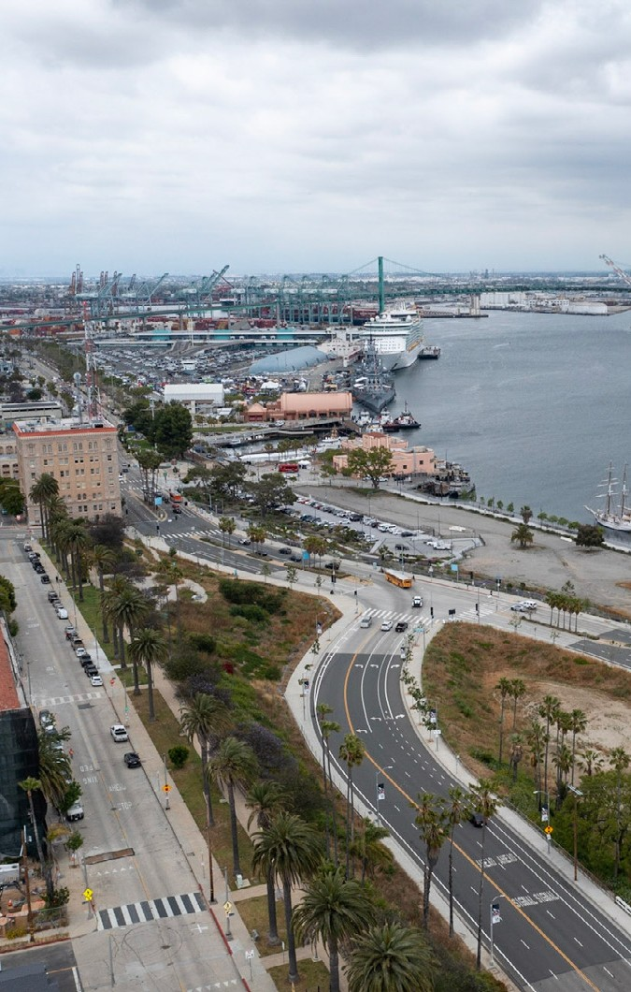
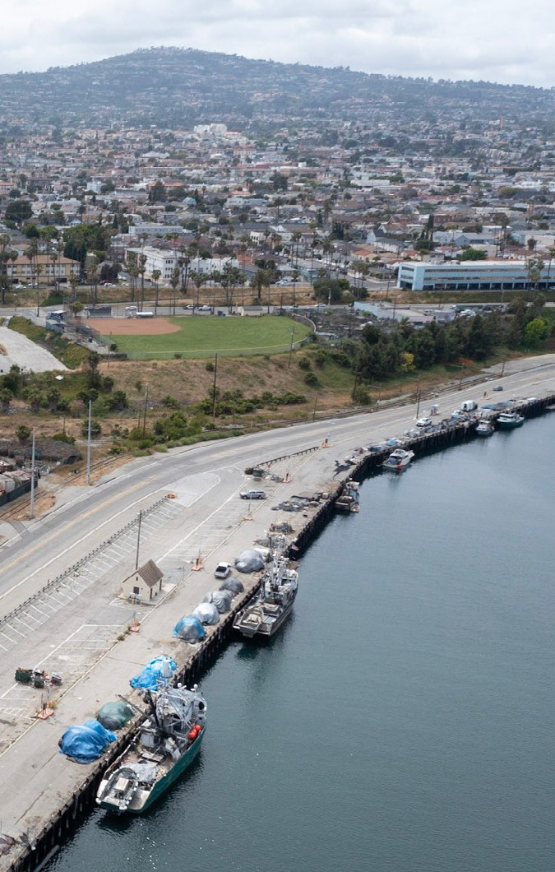
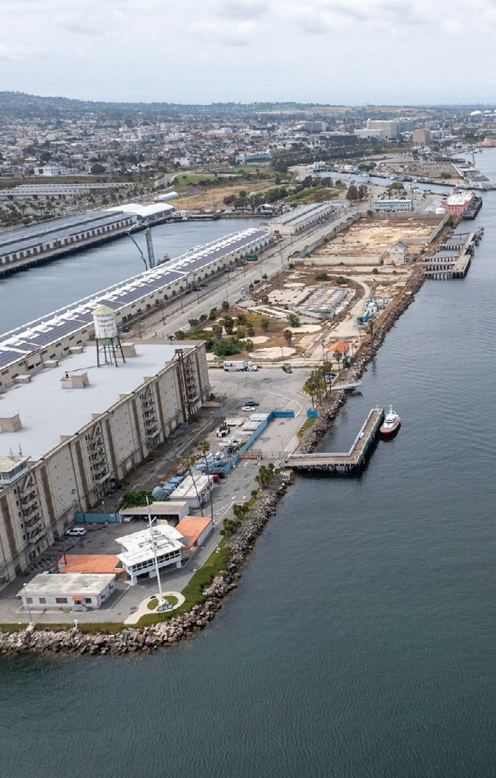
Background
LA Waterfront in San Pedro

Slide 5
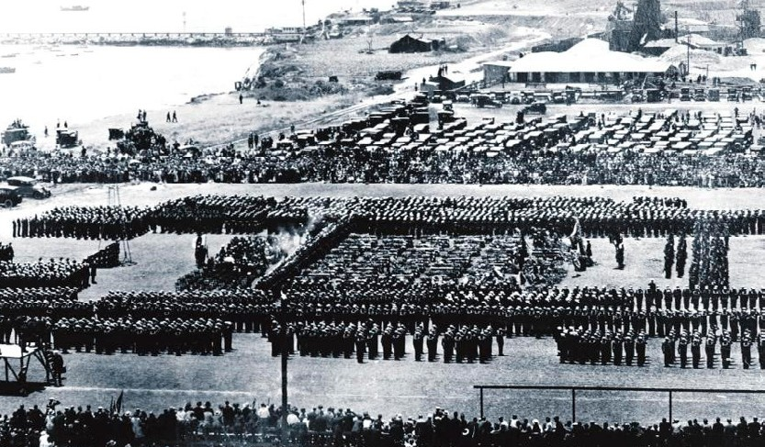
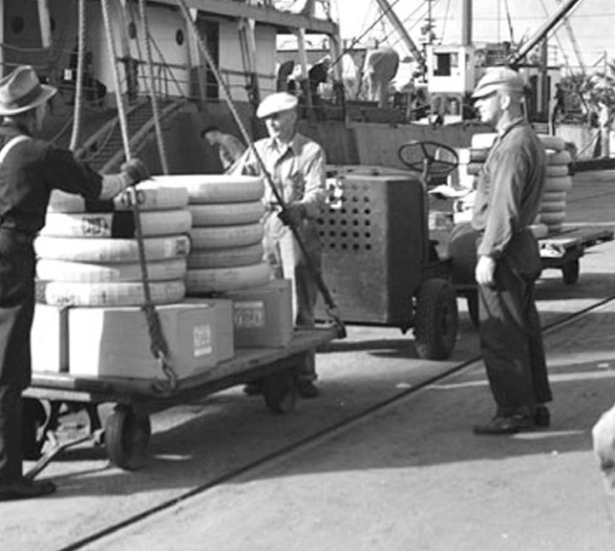
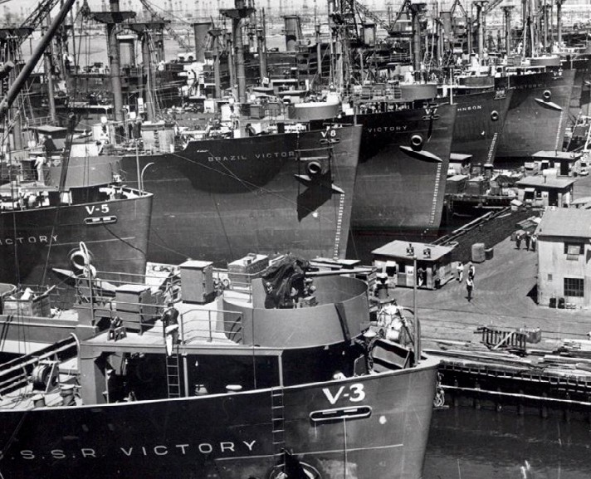
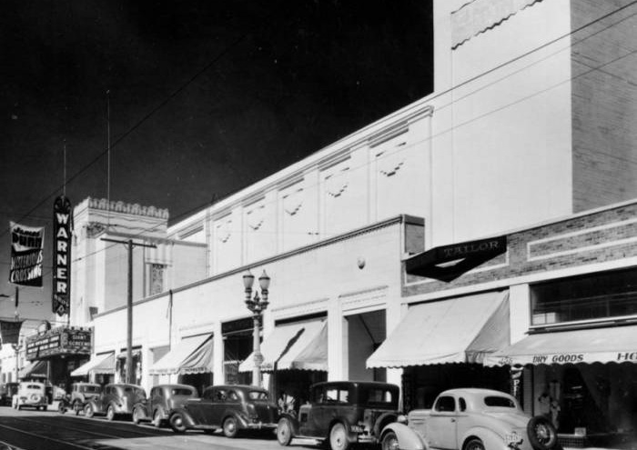
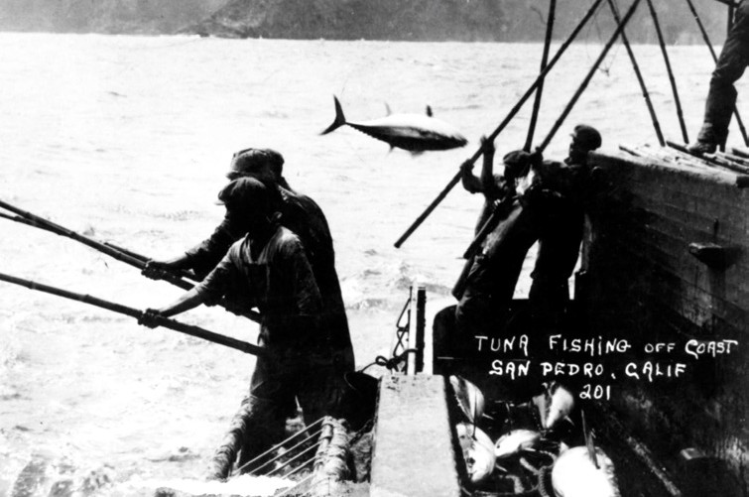
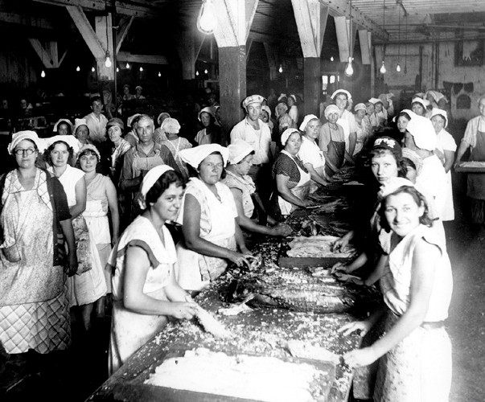
Background
History
Military
Cargo
Ship Building
Downtown Businesses
Fishing
Canning

Slide 6
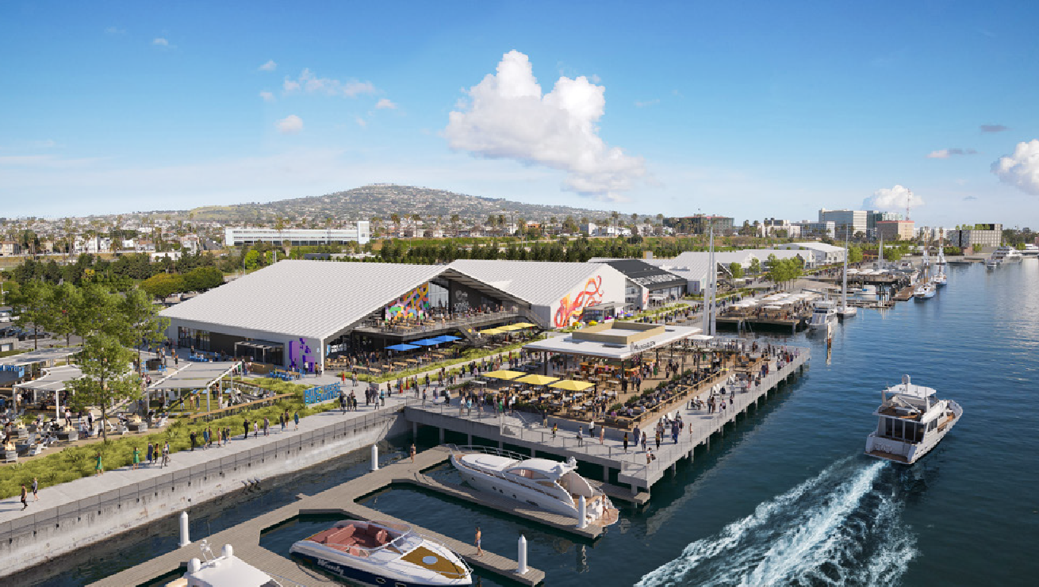
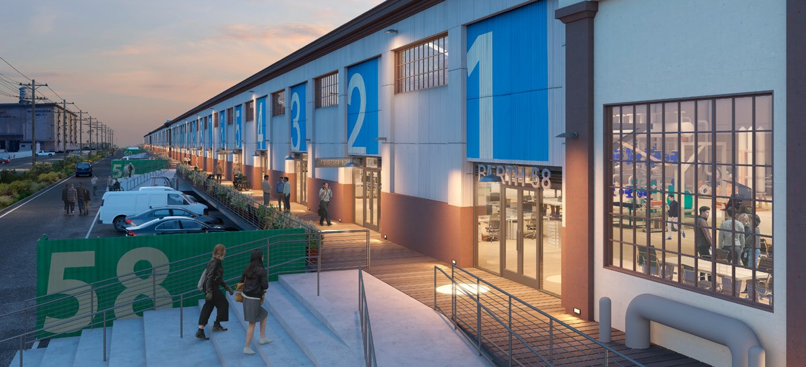
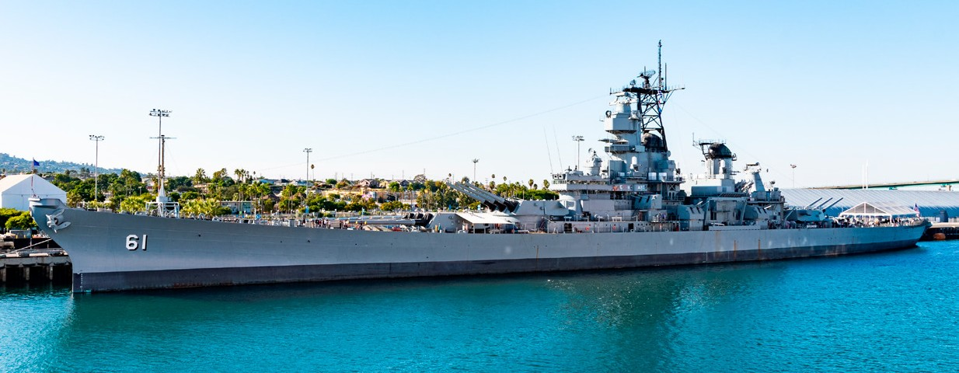
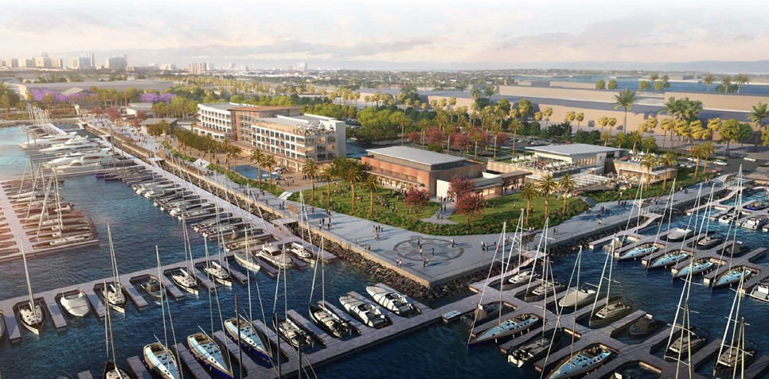
Background
Current and Future Developments
West Harbor AltaSea
PAG
Battleship U.S.S. Iowa
Cabrillo Way Marina

Slide 7
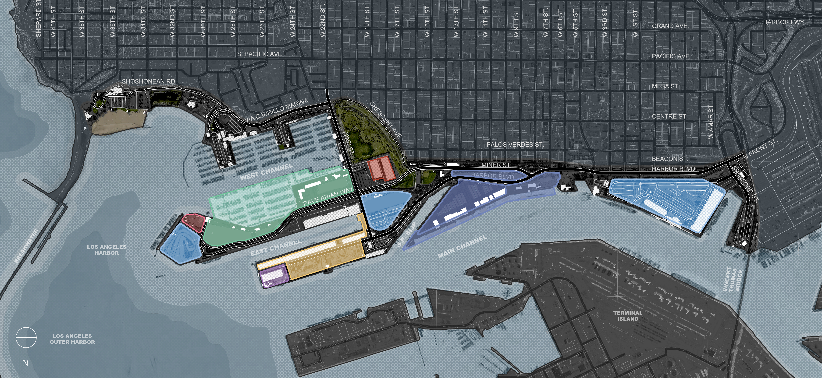
Background
Current and Future Developments
CABRILLO WAY MARINA
CRAFTED
WEST HARBOR
INNER HARBOR CRUISE TERMINAL AND PARKING LOT
BOAT REPAIR FACILITY
OUTER HARBOR CRUISE TERMINAL
WAREHOUSE ONE
ALTASEA
ADDITIONAL GENERAL PARKING

Slide 8
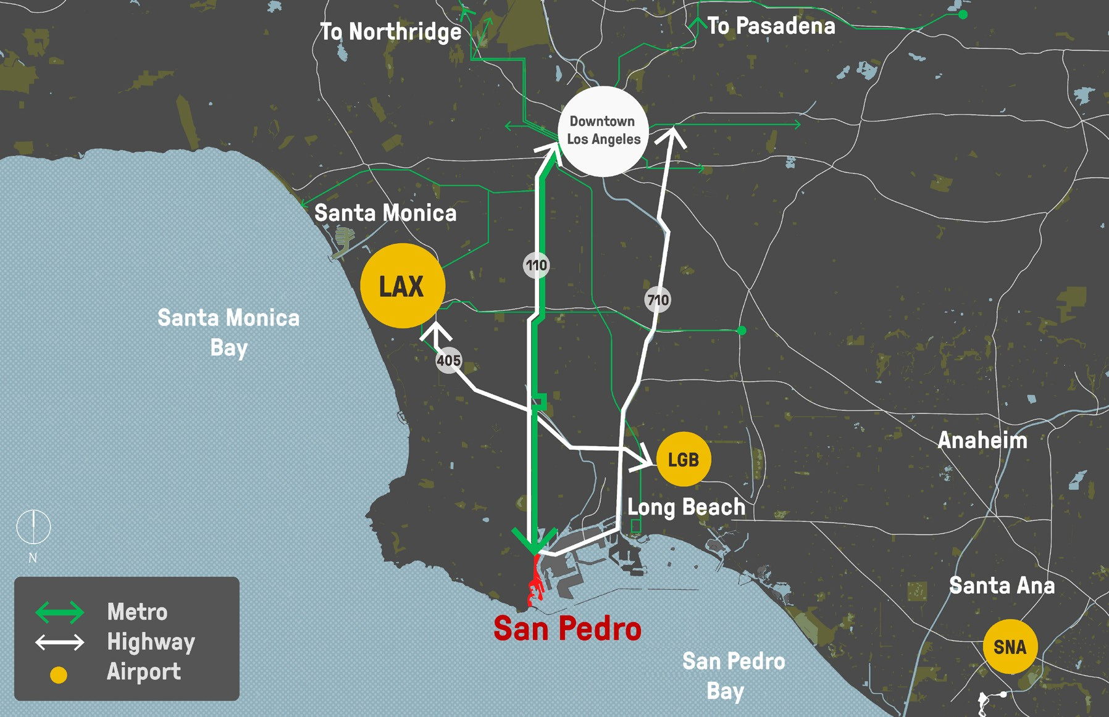
Background
Regional Context

Slide 9
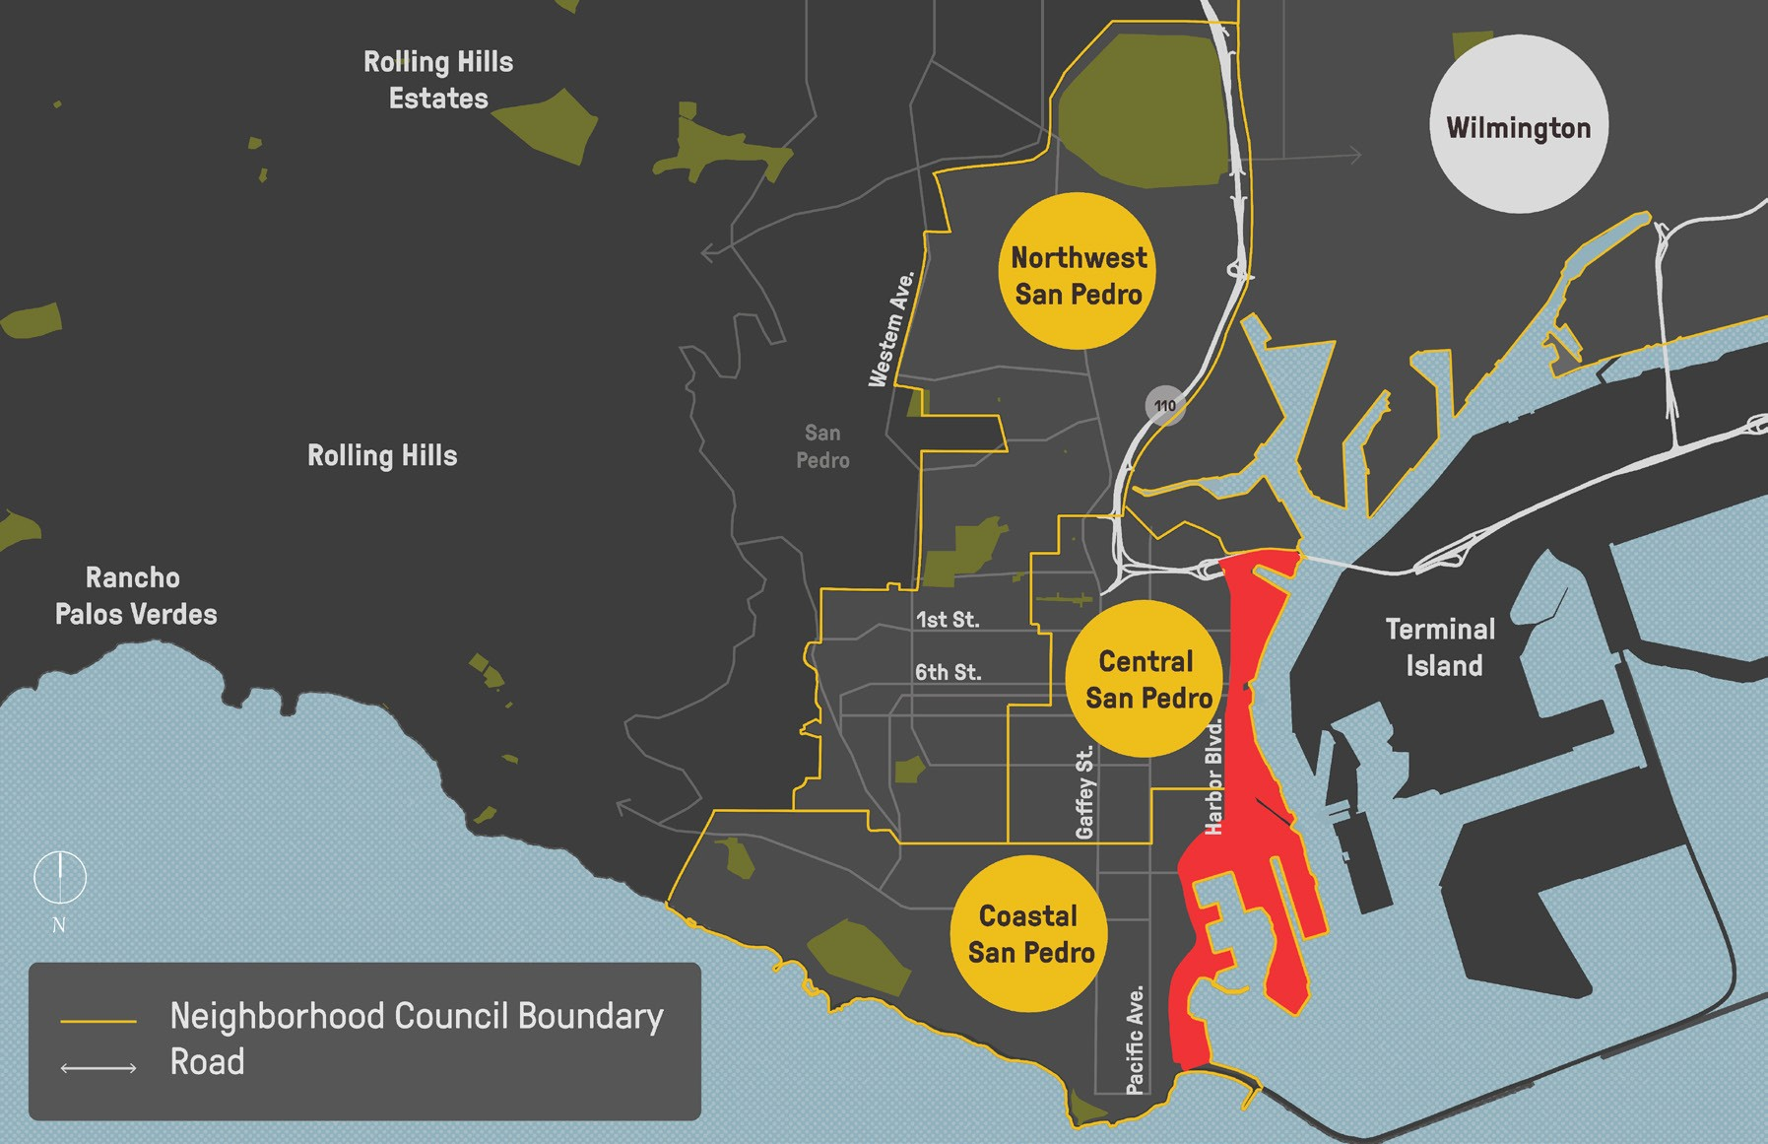
Background
Community Context

Slide 10
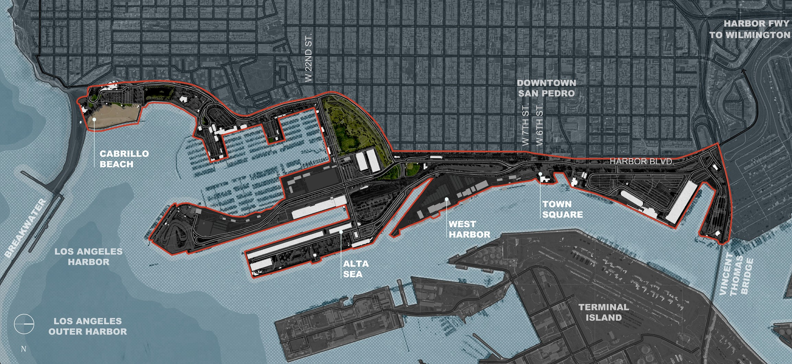
Background
460 acres & 8 miles of waterfront

Slide 11
Planning Goals
Work with what’s been done already
Set a framework for the future
Think about connectivity comprehensively Be engaging

Slide 12
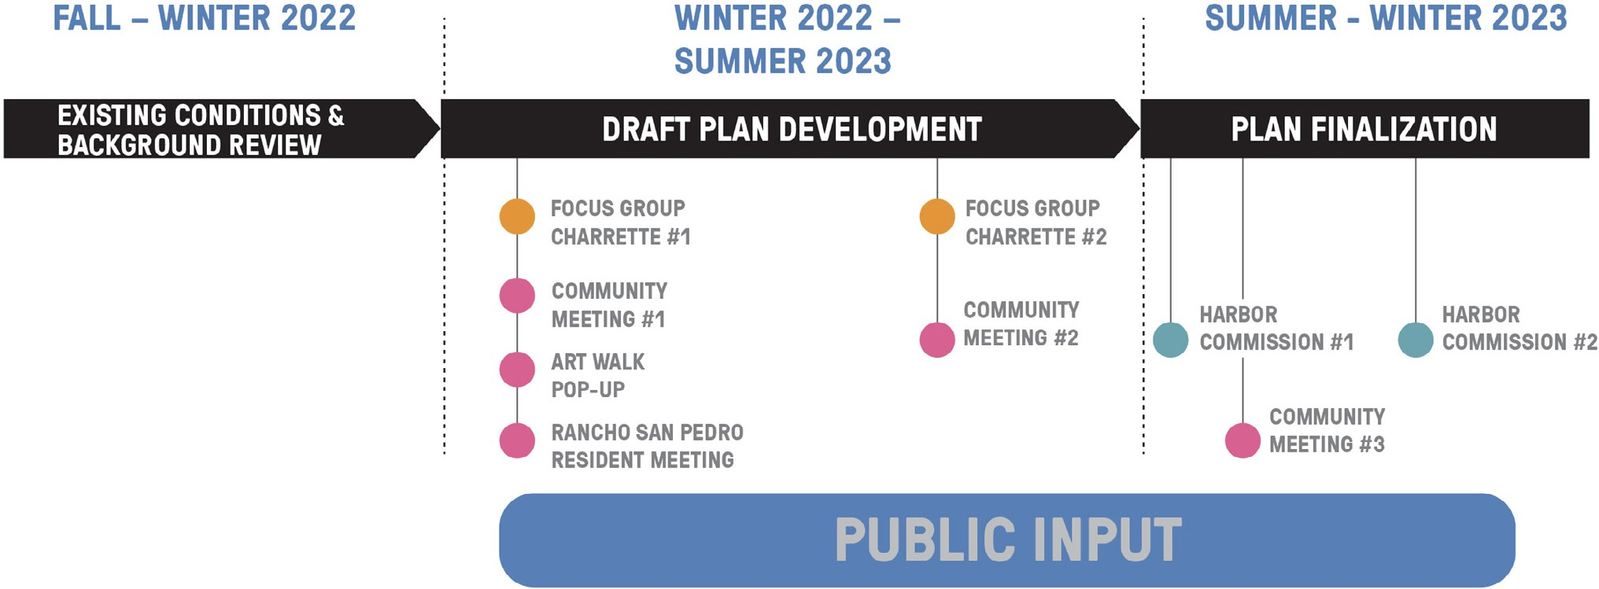
Community Engagement
Process
WE ARE HERE

Slide 13
Community Engagement
Participation
Phase 1
1. Focus Group Charrette
2. Community Workshop
3. Art Walk Pop-up
4. Rancho San Pedro Resident Meeting
Tuesday, Jan. 24, 2023, 5:30-8 pm
Presentation & 3 interactive stations
Estimated attendance: 20
Thursday, Feb. 23, 2023, 6 to 8pm
Presentation & 5 interactive stations
Estimated attendance: 80
Thursday, Mar. 2, 2023, 5 to 8pm
One interactive station at the San Pedro Art Walk
Estimated attendance: 100
Friday, April 28, 2023, 6 to 8pm
Presentation & 5 interactive stations translated
Estimated attendance: 35
Phase 2
5. Focus Group Meeting
6. Community Open House
7. Community Meeting
~315 Participants
Combined
Thursday, Jun. 8, 2023, 5:30-7 pm
Presentation & 4 interactive stations
Estimated attendance: 10-15
Thursday, Jun. 29, 2023, 6-8 pm
Presentation & 4 interactive stations
Estimated attendance: 40-50
Thursday, Sept. 28, 2023, 6-8 pm
Presentation & 4 interactive stations
Estimated attendance: 30

Slide 14
Community Engagement
What We Heard: January-June
COMMENT:
Walking and biking are important
COMMENT:
Support for public transit improvements (more stops)
COMMENT:
Trolley and water taxi help attract visitors
COMMENT:
People like the views and historic landmarks
COMMENT:
Improved signage to identify parking & destinations
COMMENT:
More amenities, and better connections between them
COMMENT:
More lighting, open space, seating, and art along the Promenades
COMMENT:
Interest in sustainability and climate resiliency
COMMENT:
Current ways of going to the waterfront are personal car or walking

Slide 15
Draft Plan Comments
What We Heard: September
COMMENT:
Walking and biking are important
COMMENT:
Support for public transit improvements (more stops & regional)
COMMENT:
Trolley and water taxi help attract visitors, & relate to history
COMMENT:
People like the views and historic landmarks
COMMENT:
Improved signage to identify parking & destinations
COMMENT:
More amenities, and better connections between them & DT Pedro
COMMENT:
More lighting, open space, seating, and art along the Promenades
COMMENT:
Interest in sustainability and climate resiliency (habitat & greening)
COMMENT:
Current ways of going to the waterfront are personal car or walking

Slide 16
Draft Plan Comments
Source | Date | Format
Harbor Commission Meeting, presentation of Draft Plan | September 7, 2023 | Verbal comment
Community Meeting, presentation of Draft Plan | September 28, 2023 | Verbal comment, Email comment
HACLA, One San Pedro | October 18, 2023 | Letter
Northwest San Pedro Neighborhood Council | January 10, 2023 November 14, 2023 | Letter
Central San Pedro Neighborhood Council | October 27, 2023 | Letter
San Pedro Bay Historical Society | November 6, 2023 | Letter

Slide 17
Project Vision
Now more than ever, people are seeking a reconnection with themselves, each other, and the natural environment around them. San Pedro’s Waterfront Connectivity Plan is the catalyst that will allow this to happen.
The primary objective of this plan will build on existing and proposed modes of mobility as a foundation to create a network of well-connected, multi-benefit spaces that are accessible and safe for all San Pedro neighborhoods and the larger region seeking to enjoy an authentic L.A. Waterfront.

Slide 18
2. Solutions

Slide 19
Connectivity Framework
Connectivity Plan Contents
Chapter 1
Overview
Chapter 2 Community Engagement
Timeline & Objectives
Phase 1:
Listen & Explore
Phase 2:
Share & Evaluate
Chapter 3 Connectivity Elements
Connecting to Local Climate Action Policy
Connectivity Framework
Chapter 4
Implementation
Introduction
Legacy of Plans and Projects
Current Conditions
Waterfront Development Market Scan
Implementation Strategy
Proposed Project Phasing
High-level Project Cost Estimates
Review the Final Connectivity Plan now on: www.lawaterfront.org/invest/current-port-projects

Slide 20
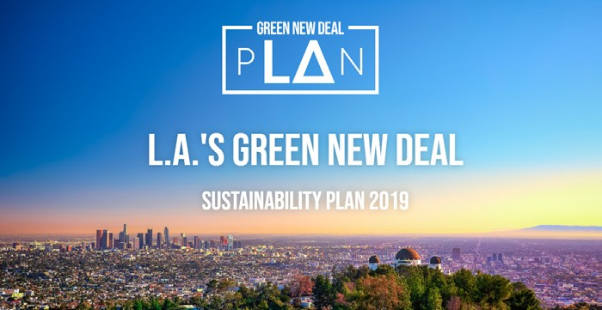
Connecting to Climate Action Policy
Relationship to LA’s Green New Deal
“The Port of Los Angeles is proud to adopt the Sustainable City pLAn for the City of Los Angeles. The pLAn advances our environment, economy and social equity in 14 various
categories with short-term, near-term (2025) and long-term (2035) targets.”
Connectivity Plan Example
Supporting Green New Deal Goals: Roadways
Connectivity Plan recommendations developed with the goals of LA’s Green New Deal in mind
Recommendations that support sustainability goals are identified throughout the Connectivity Plan
pLAn Goal 33: Local Water
Green Street projects include multi-benefit stormwater designs to improve water quality
pLAn Goal 66: Mobility & Public Transit
pLAn Goal 1111: Urban Ecosystems & Resilience
Minimizing the time spent idling in traffic and providing alternatives to driving help support the Sustainable City pLAn
Street trees and parkway vegetation can help create resilient urban ecosystems

Slide 21
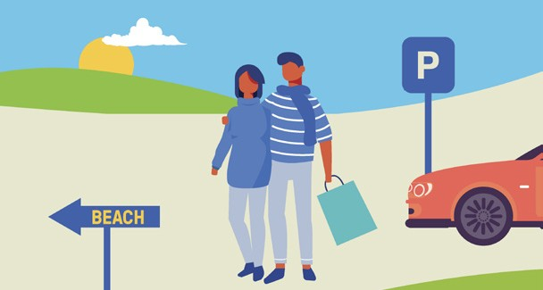
4 KEY PILLARS
Connectivity Framework
1
2
1. Park Once, Stay All Day
2. Improve Public Transit
3
3. Provide Multi-benefit
Public Access
4. Create Points of Interest
4

Slide 22
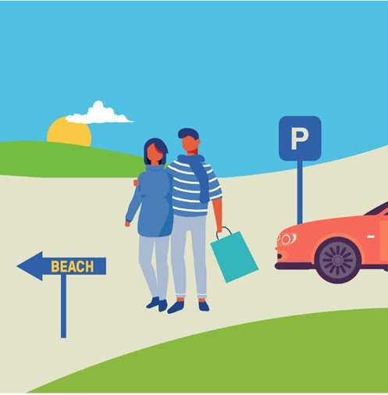
What We Heard (Issue):
Park Once, Stay All Day
Example Solutions:
There’s not enough parking
Signage to make it easier to find parking
Cruise ship terminal and event parking tram
Future phase parking
structures

Slide 23
Park Once, Stay All Day
Recommended Smart Parking System

Slide 24
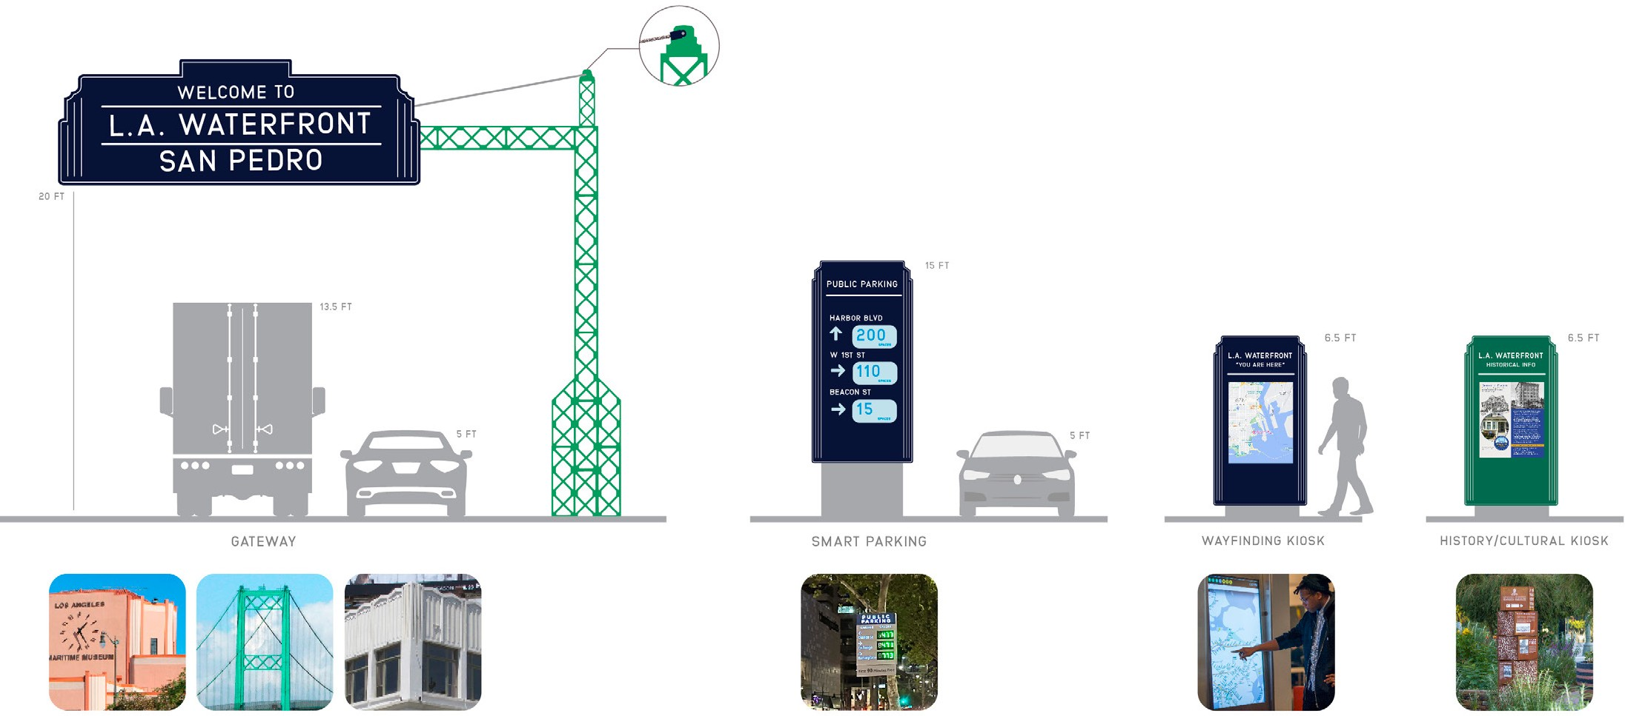
Park Once, Stay All Day
Recommended Wayfinding Signage
CURRENT SYSTEM:
L.A. WATERFRONT DESIGN GUIDELINES
GATEWAY
SMART PARKING
WAYFINDING & CULTURAL KIOSKS

Slide 25
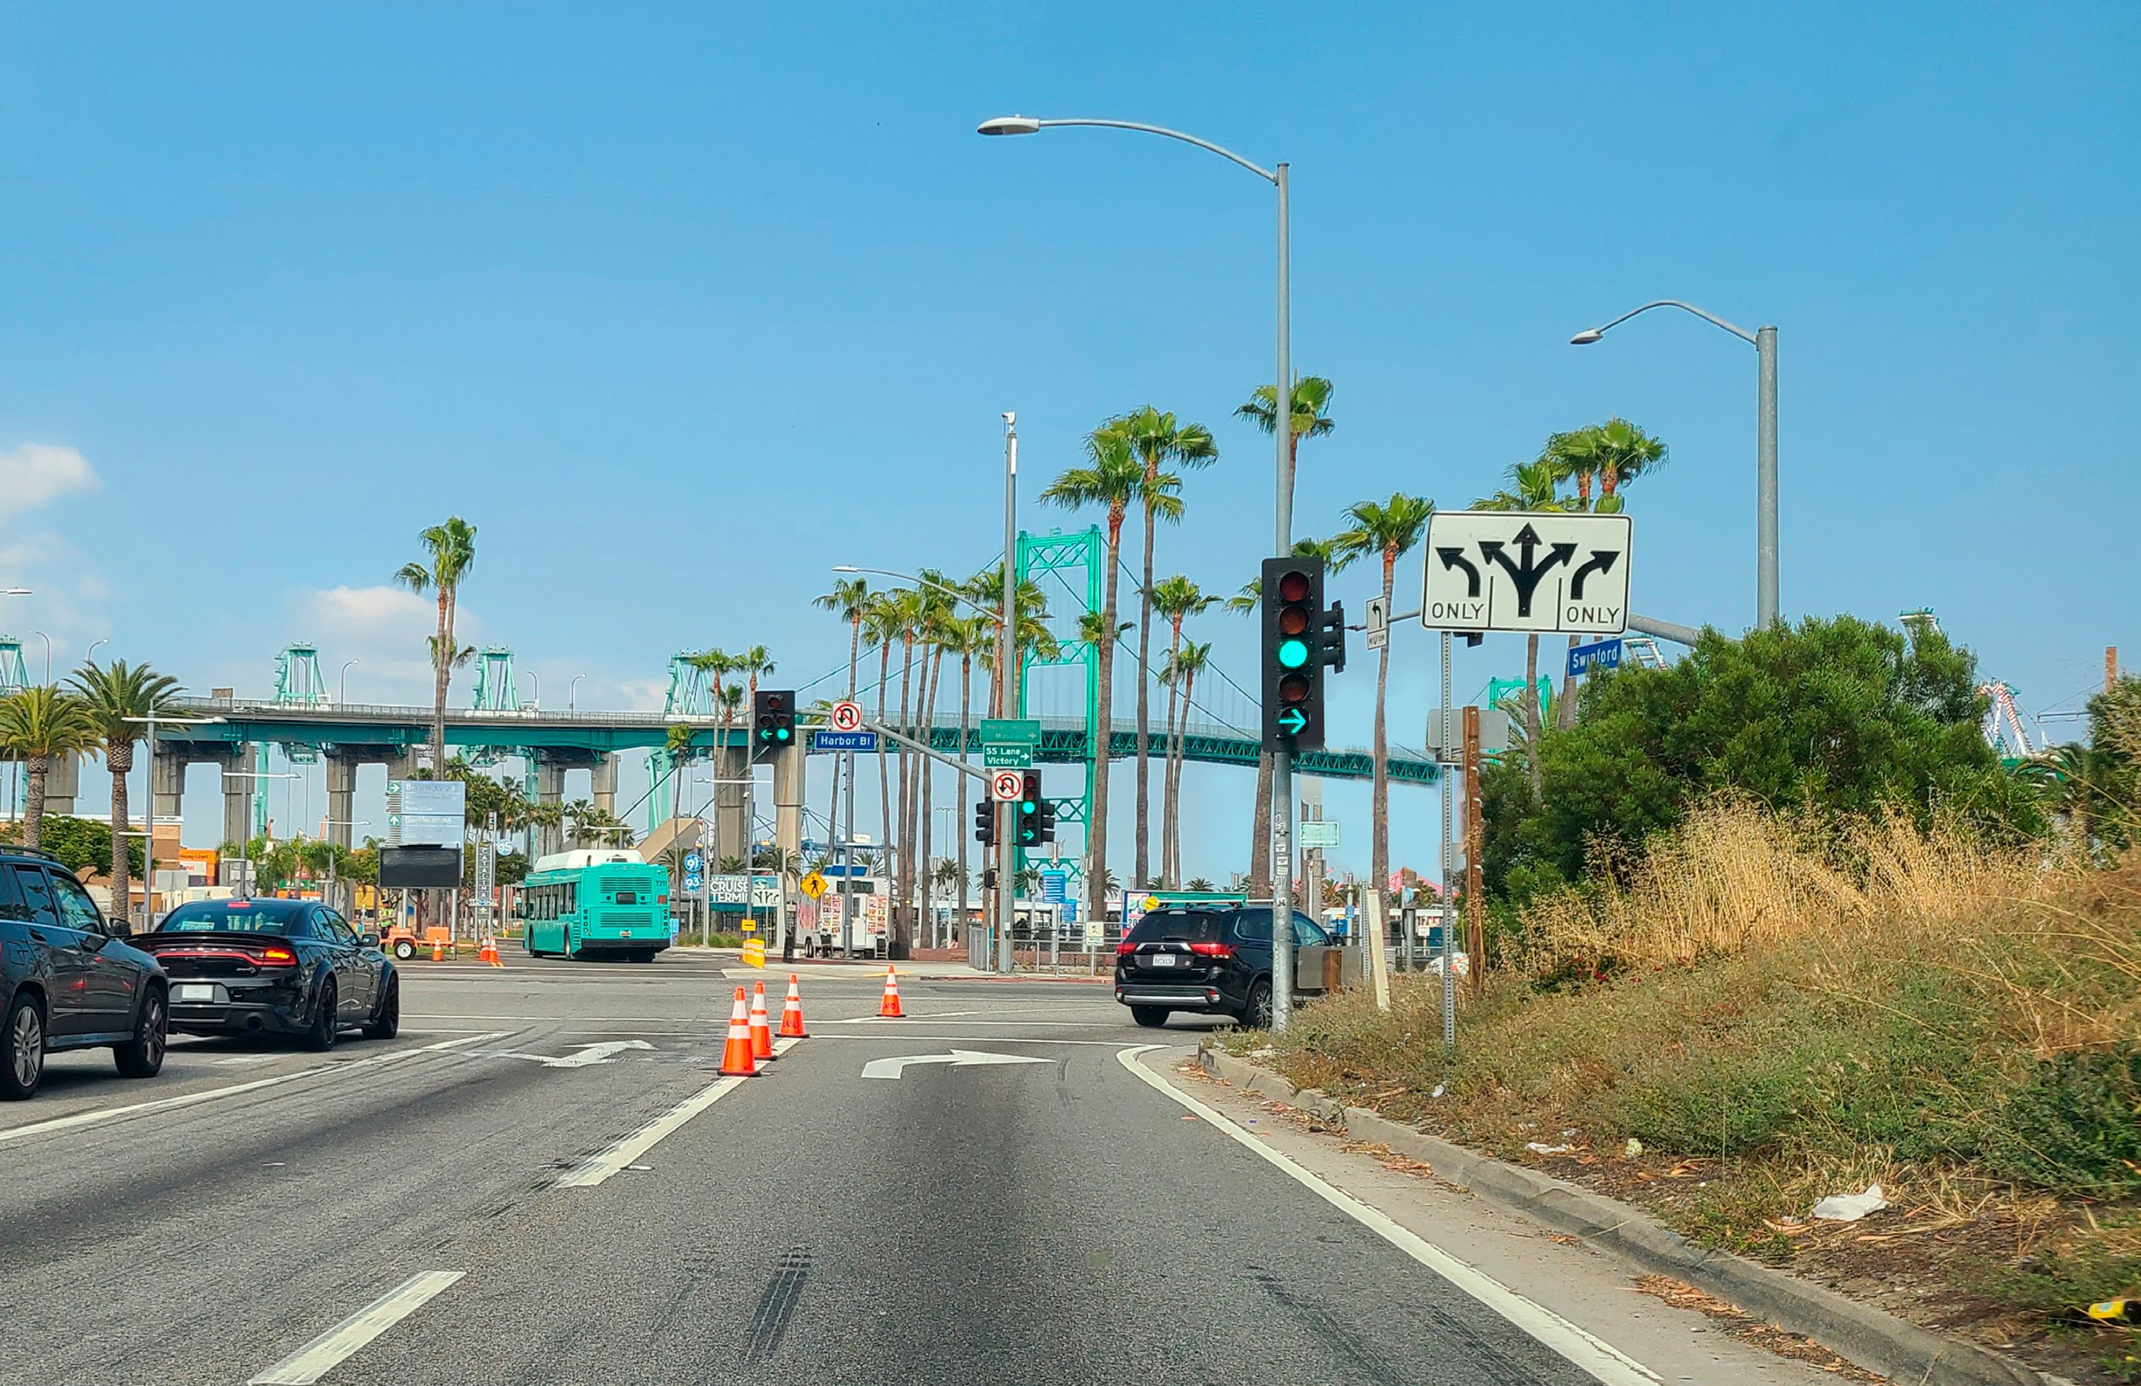
SWINFORD ST.
HARBOR
HARBOR BLVD
N
BLVD.
S
W
I
N
F
Harbor from I-110: Current
O
RD
N
SAN PEDRO’S WATERFRONT CONNECTIVITY PLAN | HARBOR COMMISSION December 7, 2023 Page 25

Slide 26
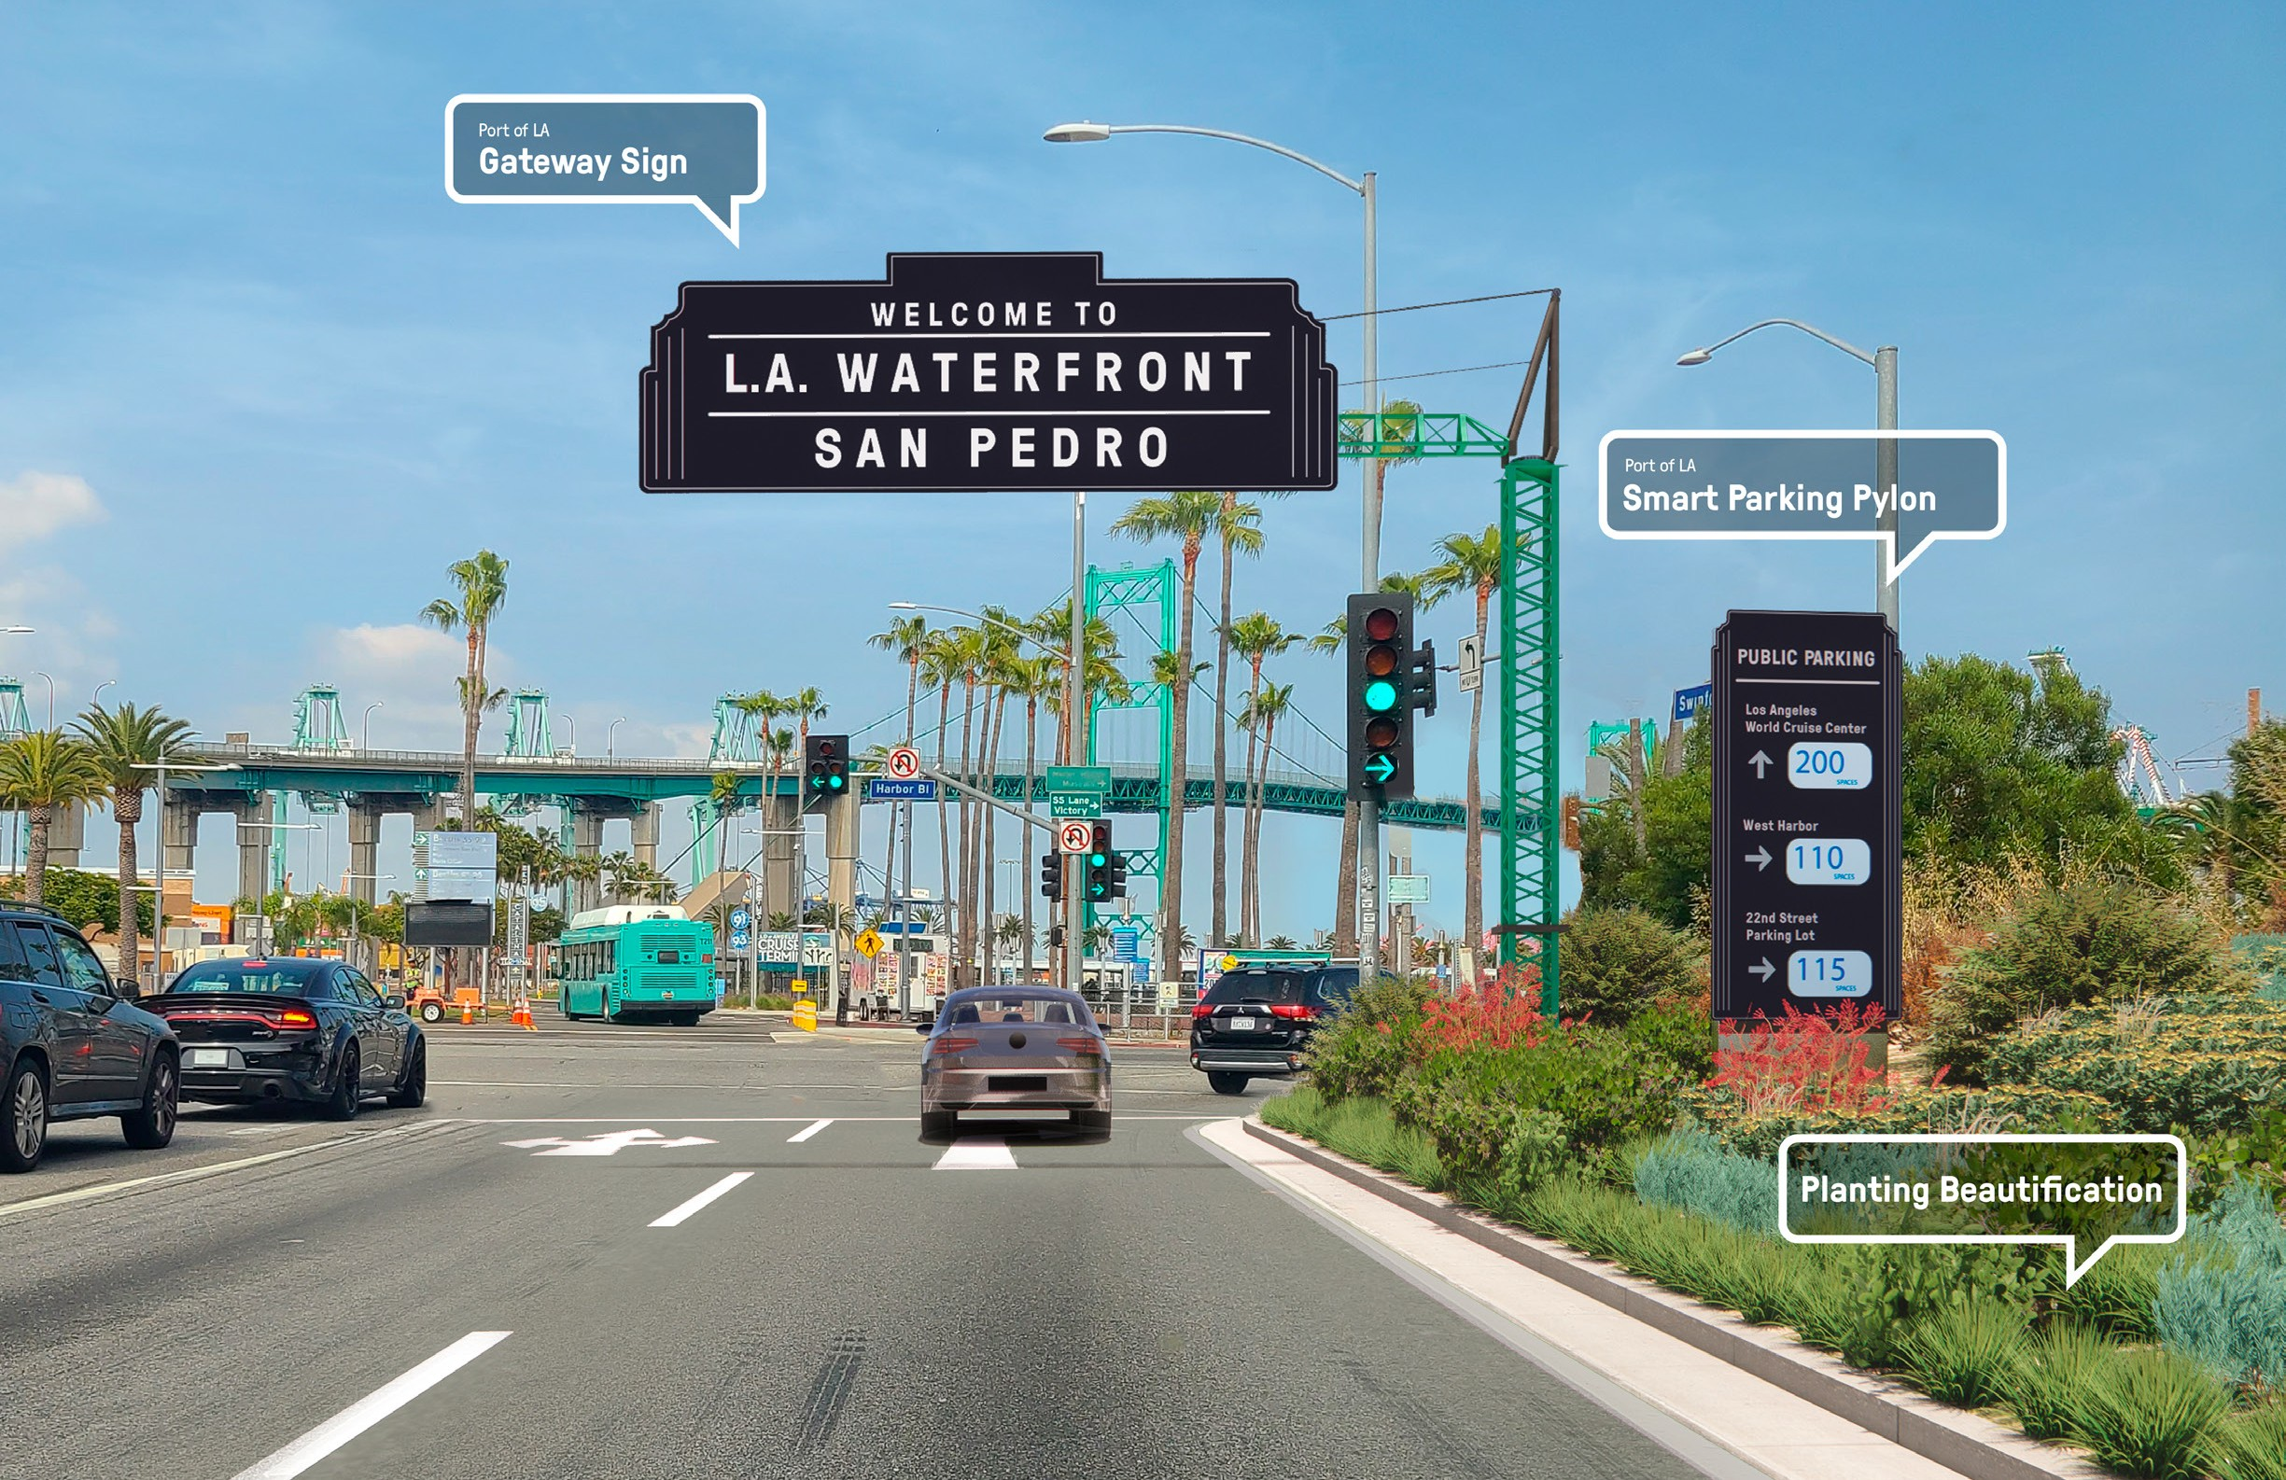
Harbor from I-110: Proposed Gateway Signage
SAN PEDRO’S WATERFRONT CONNECTIVITY PLAN | HARBOR COMMISSION December 7, 2023 Page 26

Slide 27
What We Heard (Issue):
Improve Public Transit
Example Solutions:
Pedro needs better transit service
Establish a transit hub to link service with waterfront access
Improve rubber tire trolley service
Support MTA’s proposal for light rail, LAX to L.A. Waterfront

Slide 28
Park Once, Stay All Day
Recommended Public Transit Projects

Slide 29
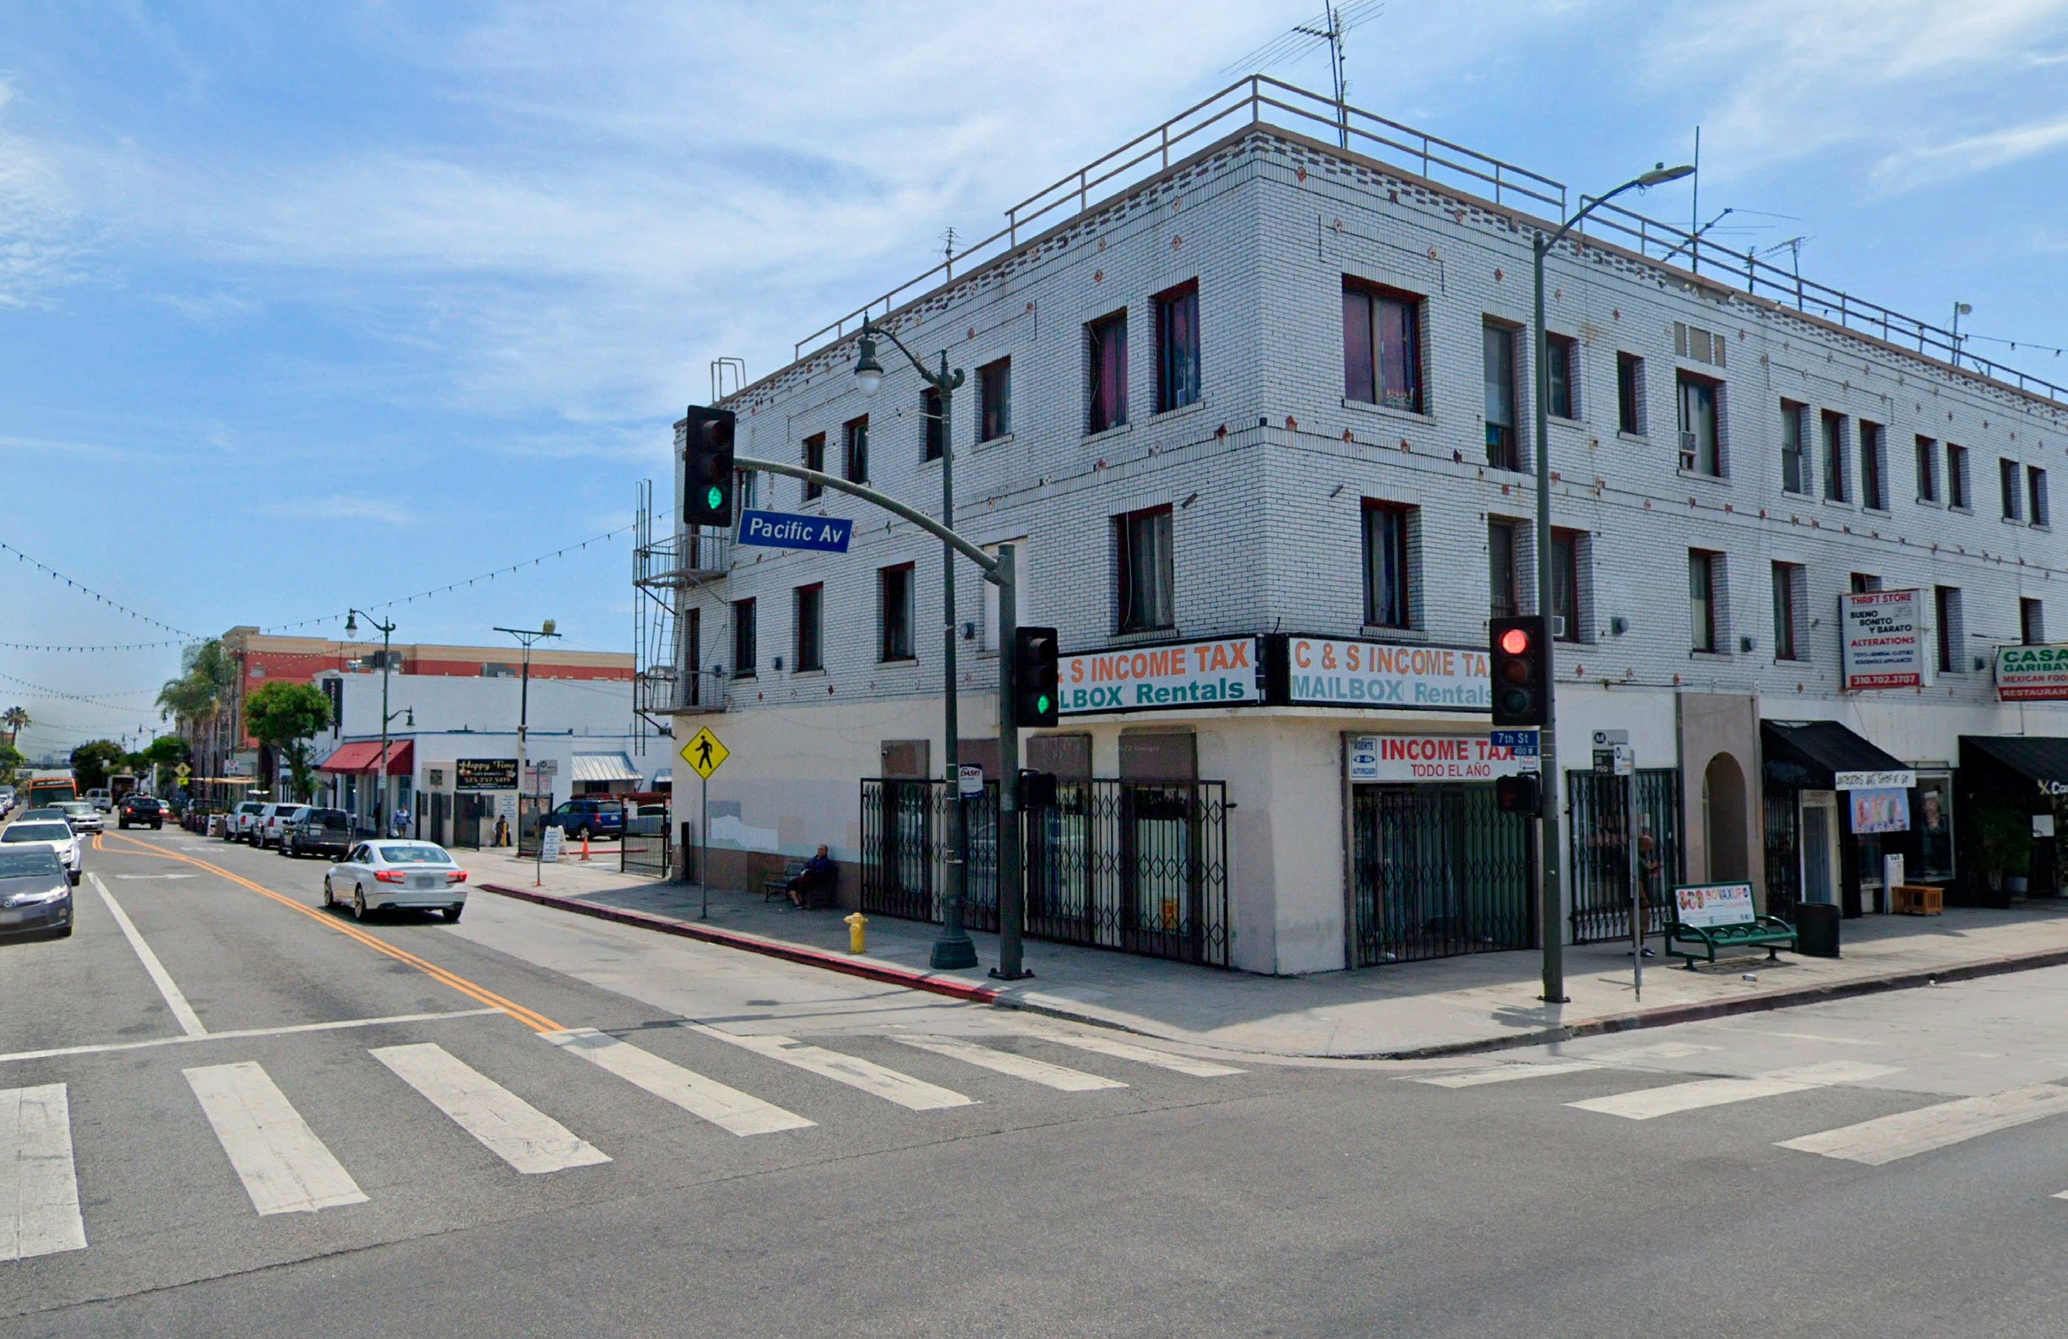
7th & Pacific: Current
PACIFIC AVE.
N
W 7TH ST
SAN PEDRO’S WATERFRONT CONNECTIVITY PLAN | HARBOR COMMISSION December 7, 2023 Page 29

Slide 30
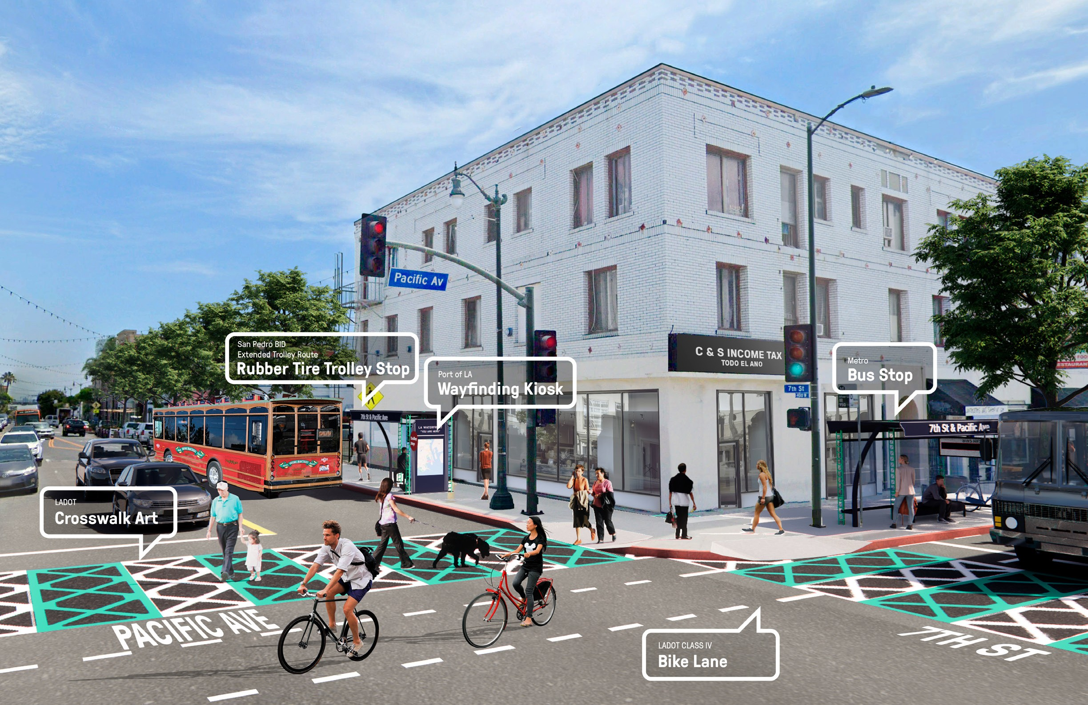
7th & Pacific: Proposed Transit Hub
SAN PEDRO’S WATERFRONT CONNECTIVITY PLAN | HARBOR COMMISSION December 7, 2023 Page 30

Slide 31
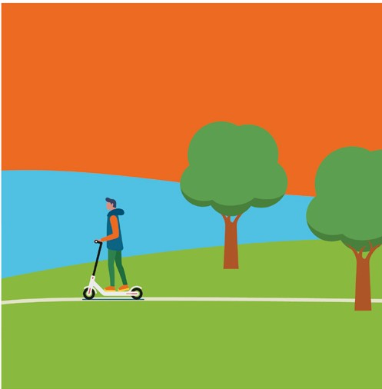
What We Heard (Issue):
Create Multi-benefit Public Access
Example Solutions:
We need a more connected bike & walking path
Provide a continuous shared use promenade from Catalina Express to the breakwater
Enhance pedestrian and bike connections between San Pedro’s neighborhoods, Wilmington, and the waterfront
Promote universal access for all abilities

Slide 32
Provide Multi-Benefit Public Access
Existing Promenade

Slide 33
Provide Multi-Benefit Public Access
Recommended Continuous Promenade

Slide 34
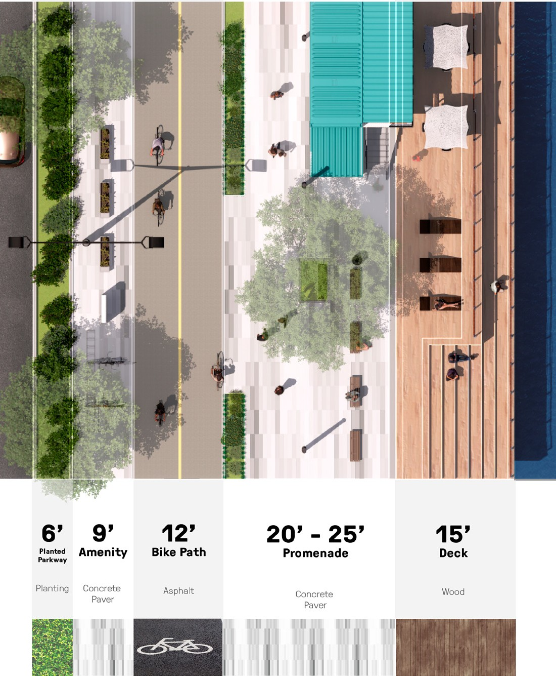
Key Recommendations
Promenade Design Recommendations
At least 20 to 25 feet wide
Ample space for shared circulation between pedestrians and
non-motorized wheels
Open space amenities, including seating, lighting, waste receptacles
Material selection and design individualized for the character of each site
Design should reflect the overall identity of San Pedro’s waterfront

Slide 35
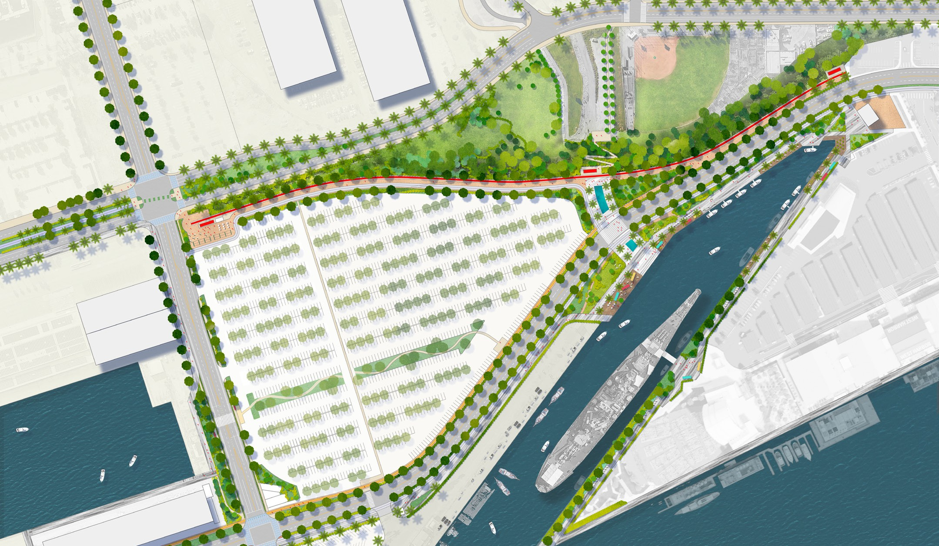
Provide Multi-Benefit Public Access
Activation at the
CRAFTED & BROUWERIJ WEST
Multi-modal Rail to Trail
S.P. Slip
BLOCH FIELD
Neighborhood connector trail
MINER ST
Shared use promenade
22ND ST
HARBOR BLVD
WEST HARBOR
Potential relocation of USS Iowa
Commercial fishing area
ALTASEA

Slide 36
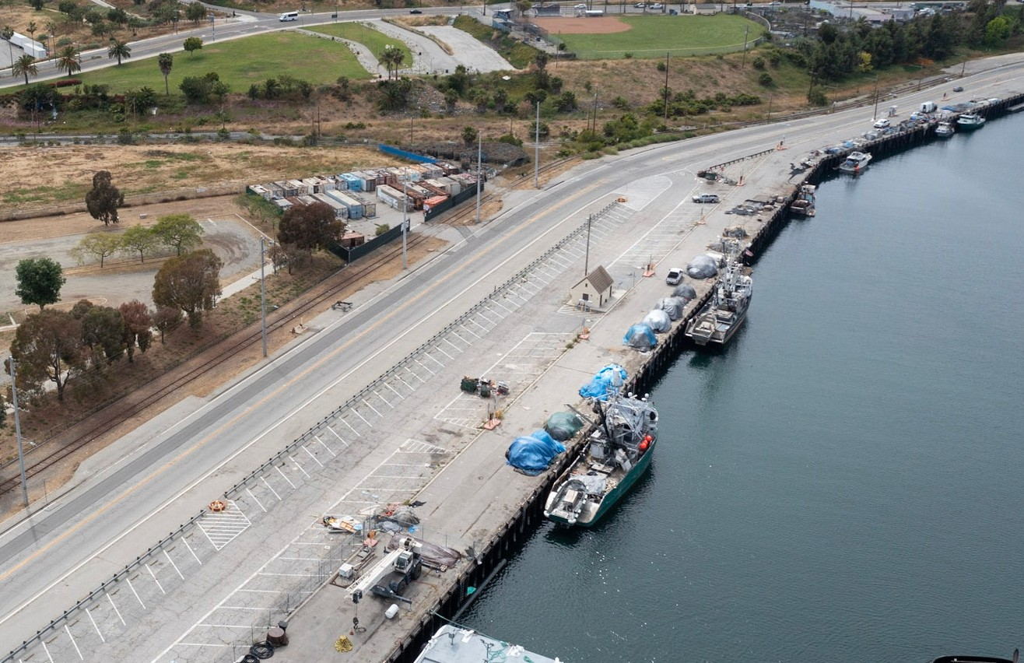
S.P. Slip: Current
MINER ST.
N
S.P. SLIP
HARBOR BLVD.
SAN PEDRO’S WATERFRONT CONNECTIVITY PLAN | HARBOR COMMISSION December 7, 2023 Page 36

Slide 37
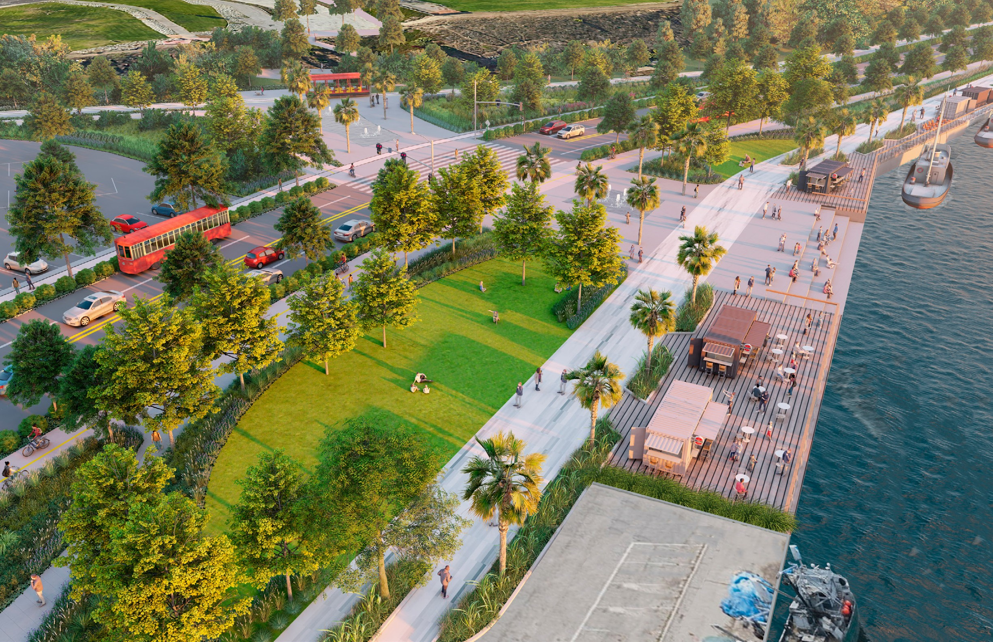
S.P. Slip: Proposed Promenade & Open Space
HARBOR BLVD
SP SLIP
SAN PEDRO’S WATERFRONT CONNECTIVITY PLAN | HARBOR COMMISSION December 7, 2023 Page 37

Slide 38
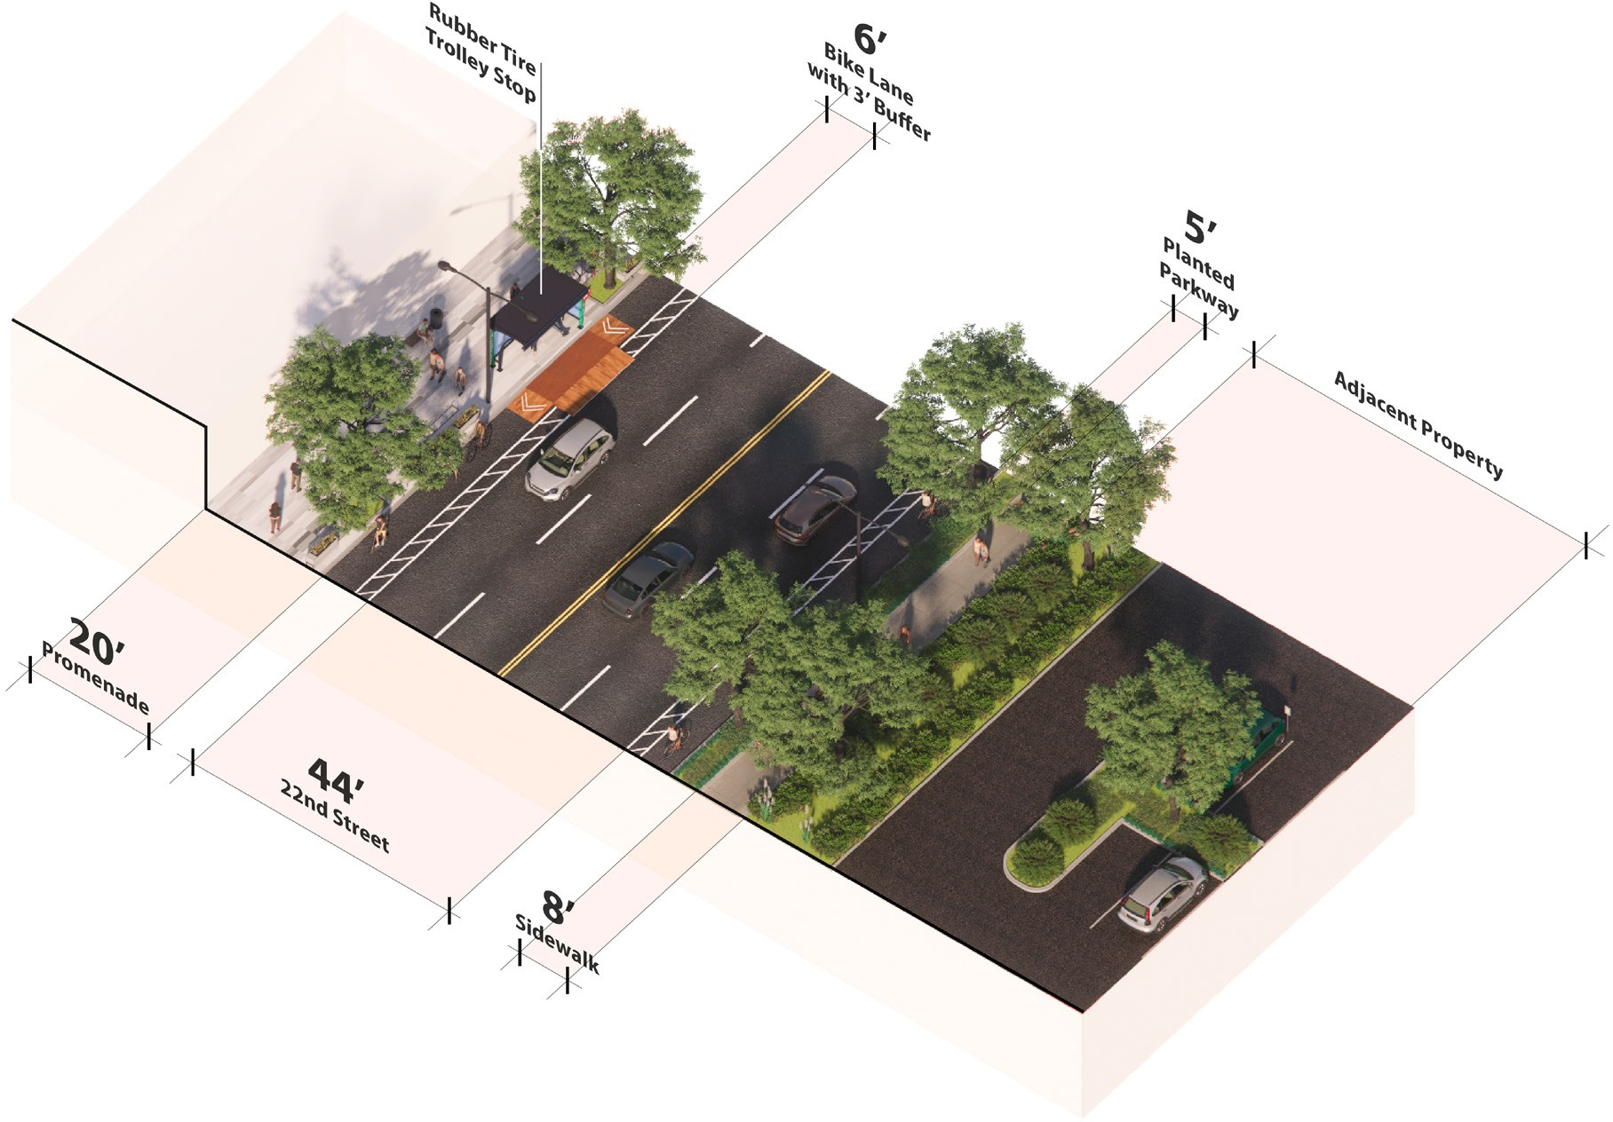
22nd Street: Proposed Complete Street
N
E 22ND ST
SIGNAL ST
DAVE ARIAN WAY

Slide 39
What We Heard (Issue):
Create Points of Interest
Example Solutions:
Showcase San Pedro’s art culture with a public art plan
Provide an historic trolley car attraction for family fun
Provide family-friendly public restrooms
Include habitat for 1% of L.A. Waterfront area
More shade, more places to sit, more things to do

Slide 40
Create Points of Interest
Open Space Design Recommendations
Comfort & Safety
Shade
Lighting
Seating
Drinking fountains
Family-friendly restrooms
Recreation
Playgrounds
Picnic areas
Pet amenities
Sports & exercise
Games for all ages
History, art, & culture
Accessibility
Pathways
Seating selection
Restroom design
Recreation amenities
Urban Greening & Habitat
Native vegetation
Canopy trees
Stormwater BMPs
1% for habitat

Slide 41
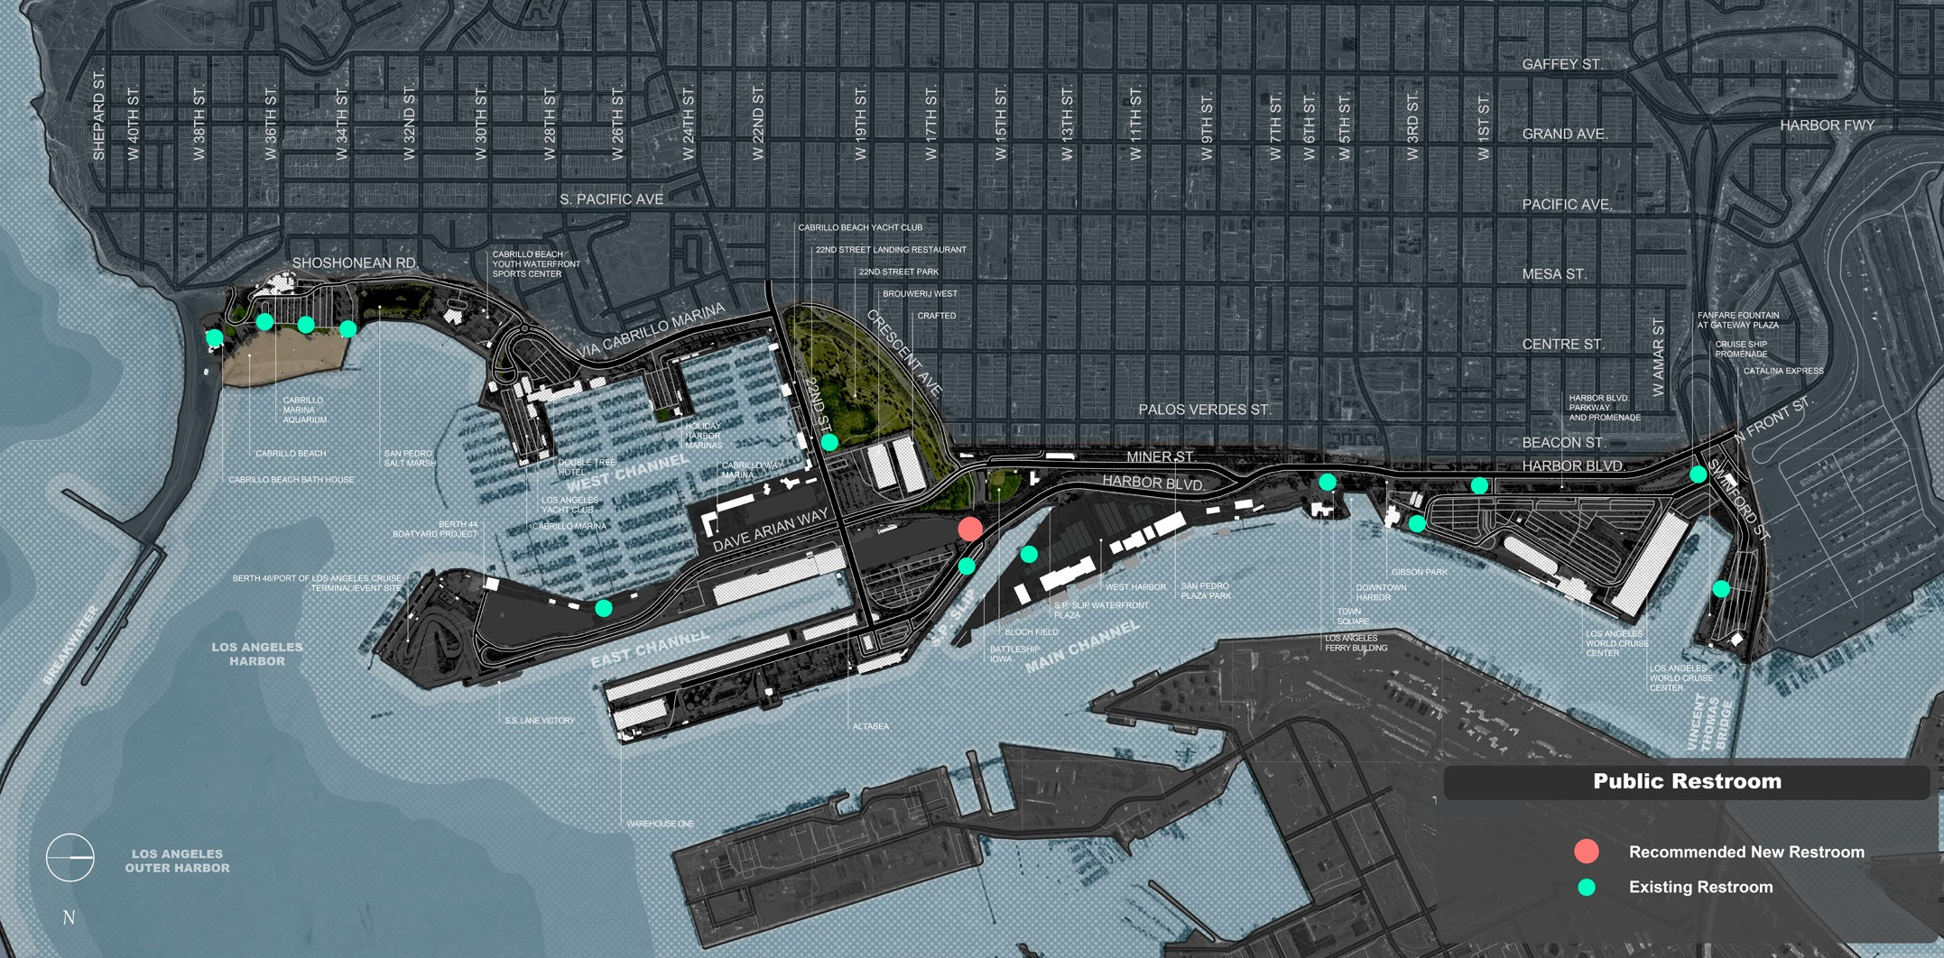
Create Points of Interest
Public Restrooms

Slide 42
Create Points of Interest
Habitat Opportunities

Slide 43
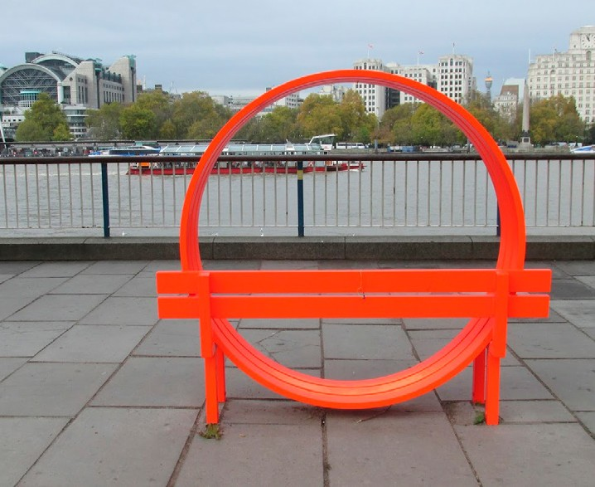
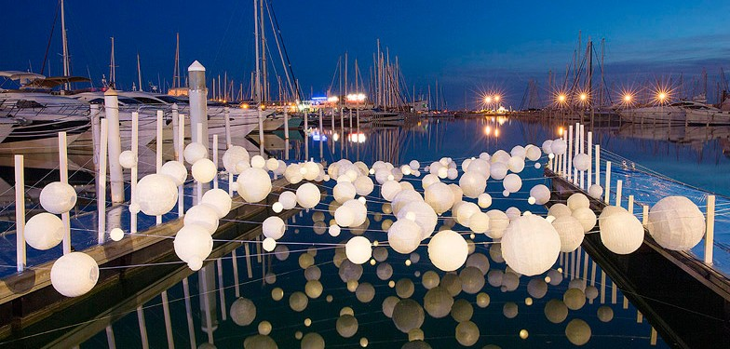
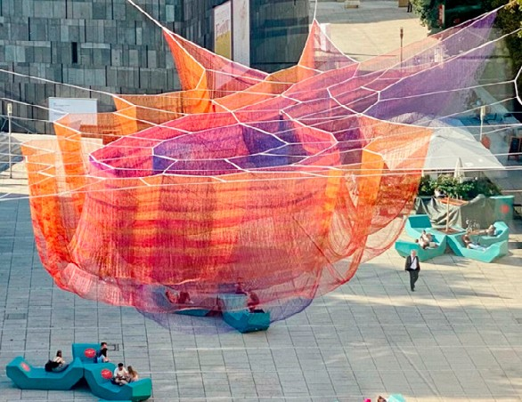
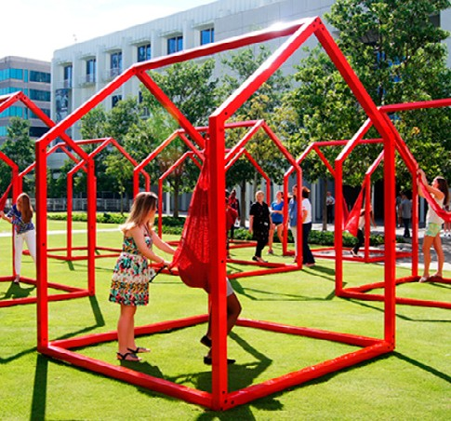
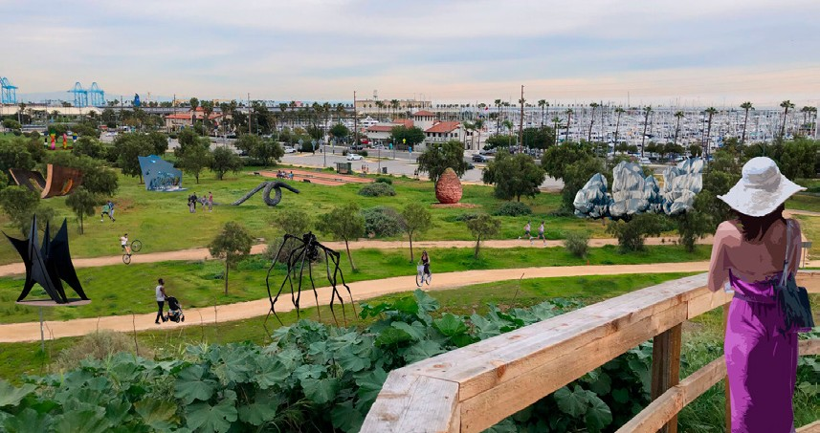
Create Points of Interest
Recommended Art Installations (Examples)
Promenade
Water
Plaza
Park
22nd Street Park Sculpture Park
Conceptual design by flow@PORT

Slide 44
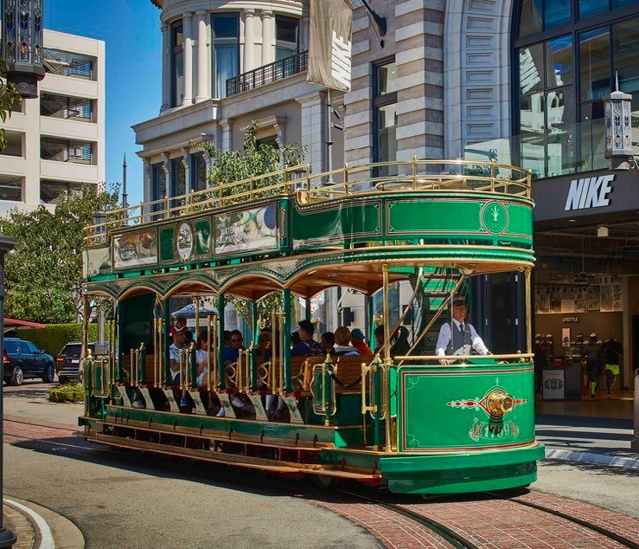
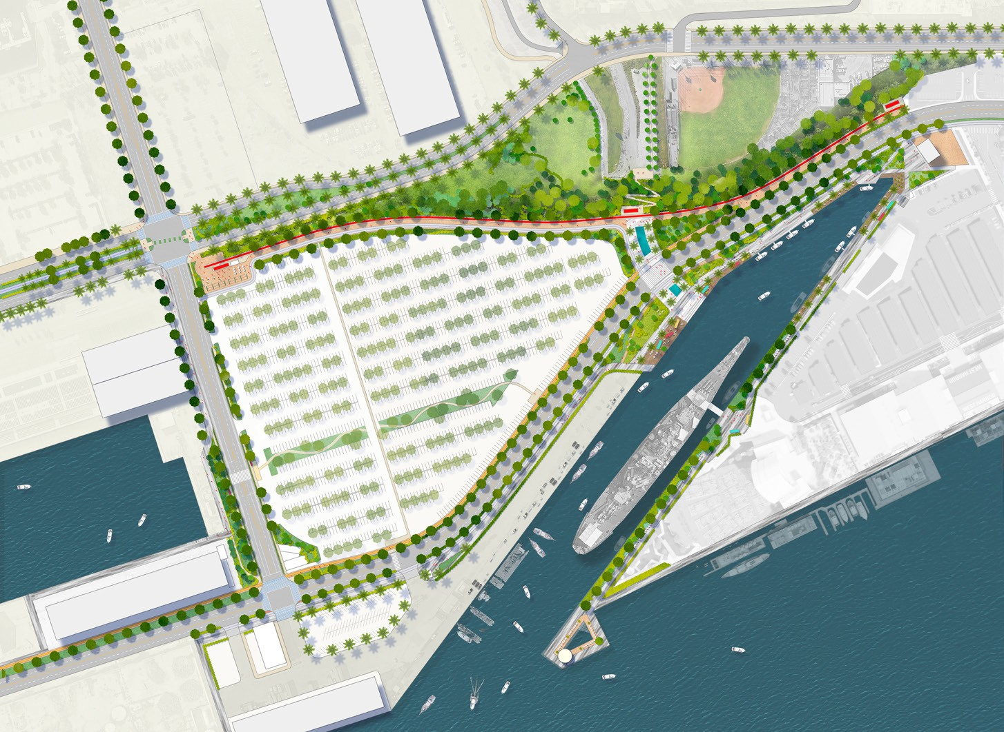
Create Points of Interest
Recommended Historic Trolley Attraction
CRAFTED & BROUWERIJ WEST
22ND ST
BLOCH FIELD
MINER ST
HARBOR BLVD
WEST HARBOR
Precedent: The Grove Trolley
Free!
Inductive power
Shares pedestrian space
1-3:45pm; 5-8:45pm daily
N

Slide 45
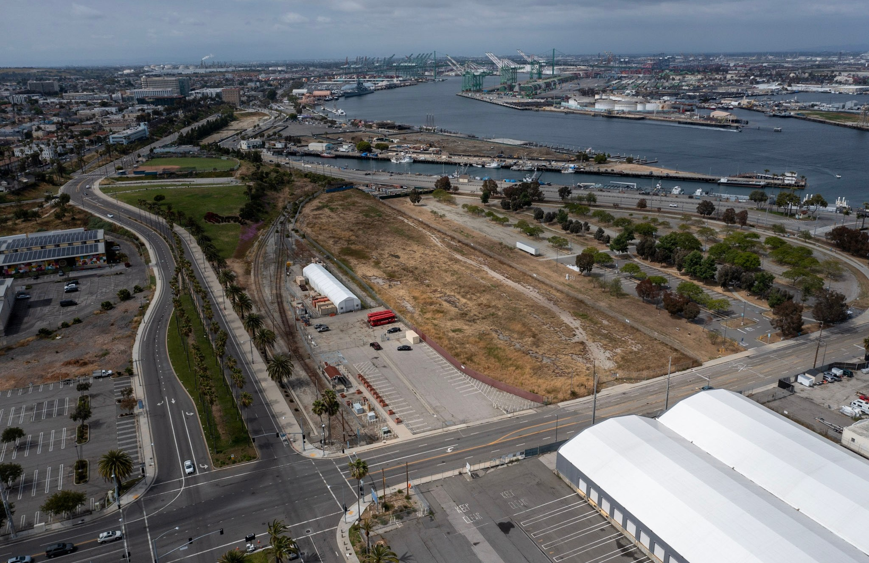
22nd & Miner: Current
N
MINER ST
E 22ND ST
SAN PEDRO’S WATERFRONT CONNECTIVITY PLAN | HARBOR COMMISSION December 7, 2023 Page 45

Slide 46
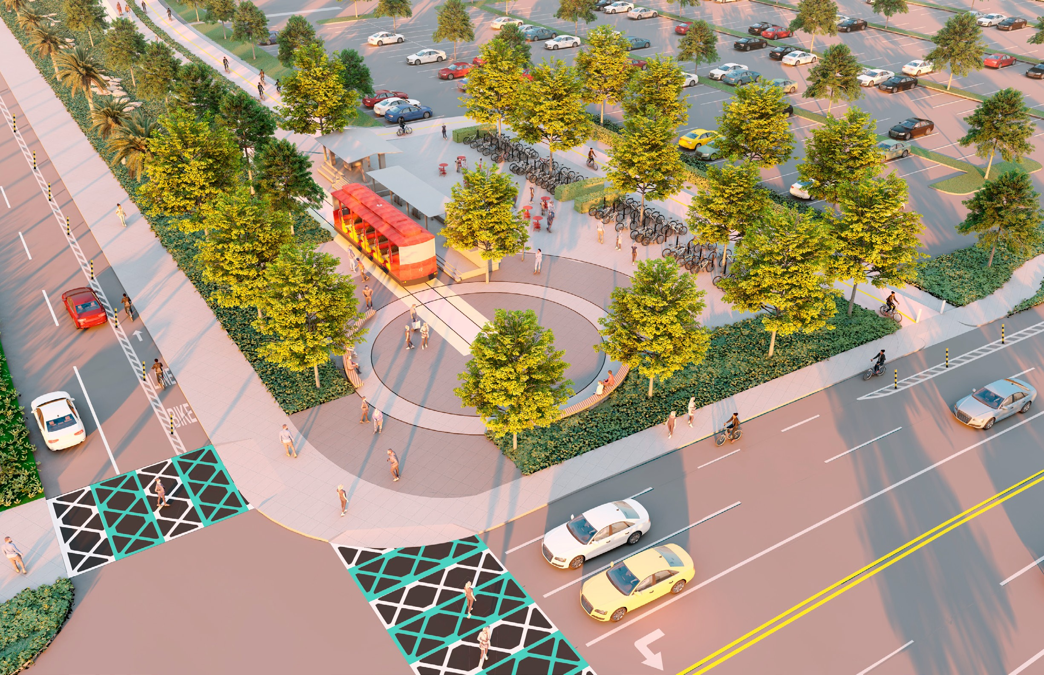
22nd & Miner: Proposed Trolley Attraction
& Mobility Hub
MINER ST
22ND ST
SAN PEDRO’S WATERFRONT CONNECTIVITY PLAN | HARBOR COMMISSION December 7, 2023 Page 46

Slide 47
3. Next Steps

Slide 48
Project Timeline
Finalizing the Plan
Dec. 7, 2023: Presentation of final plan
Dec. 8-15, 2023: Plan project closeout
WE ARE HERE

Slide 49
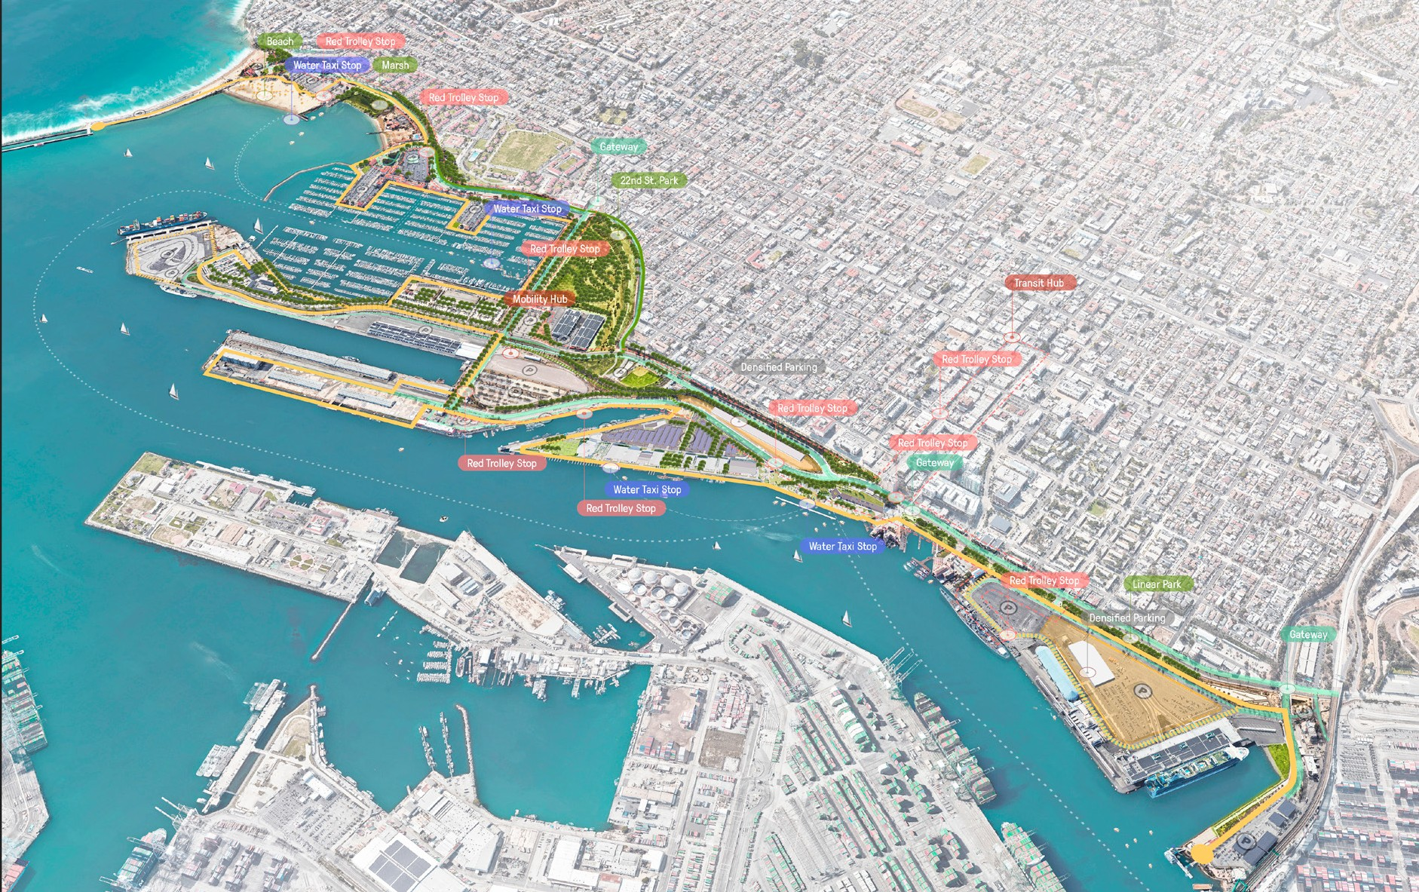
Any Questions?

